Slide 1



SvD EMEA V2
View in Power BI
Last data refresh:
6/30/2023 9:05:26 AM UTC
Downloaded at:
6/30/2023 9:45:30 AM UTC

Slide 2

Welcome Page
Notes:
Text Parameters
No alt text provided
Text Period
No alt text provided
Text Full Year
No alt text provided
Image Parameters
No alt text provided
Text Disclaimer
No alt text provided
Slicer Full Year
No alt text provided
Text Period
No alt text provided
Slicer Period
No alt text provided
Text Units
No alt text provided
Slicer Units
No alt text provided
Text Divisor
No alt text provided
Slicer Divisor
No alt text provided
Image Disclaimer
No alt text provided
Slicer Currency
No alt text provided
Text Period
No alt text provided
Slicer Period
No alt text provided
Personae Text
No alt text provided
Slicer Period
No alt text provided
Image Personae
No alt text provided
Image Management
No alt text provided
Text Management
No alt text provided
Title Personae
No alt text provided
Image Sales
No alt text provided
Text Sales
No alt text provided
Image Finance
No alt text provided
Text Finance
No alt text provided
shape
No alt text provided
textbox
No alt text provided
shape
No alt text provided
textbox
No alt text provided
image
No alt text provided
textbox
No alt text provided
textbox
No alt text provided
image
No alt text provided
textbox
No alt text provided
image
No alt text provided
image
No alt text provided
shape
No alt text provided
textbox
No alt text provided
image
No alt text provided
textbox
No alt text provided
image
No alt text provided
textbox
No alt text provided
image
No alt text provided
textbox
No alt text provided
image
No alt text provided
textbox
No alt text provided
image
No alt text provided
image
No alt text provided
textbox
No alt text provided
textbox
No alt text provided
image
No alt text provided
textbox
No alt text provided
image
No alt text provided
textbox
No alt text provided
image
No alt text provided
shape
No alt text provided
shape
No alt text provided
shape
No alt text provided
Image GTR
No alt text provided
Text Open
No alt text provided
Image Open
No alt text provided
Text Close
No alt text provided
Text Closing box
No alt text provided
Image Close
No alt text provided
Text Home Page
No alt text provided
Home Page Button
No alt text provided
Closing box 2
No alt text provided
Closing box 3
No alt text provided
Image Menu
No alt text provided
Text Menu
No alt text provided
Image Signs description
No alt text provided
Title Signs description
No alt text provided
shape
No alt text provided
shape
No alt text provided
shape
No alt text provided
shape
No alt text provided
textbox
No alt text provided
shape
No alt text provided
textbox
No alt text provided
textbox
No alt text provided
shape
No alt text provided
image
No alt text provided
textbox
No alt text provided
textbox
No alt text provided
image
No alt text provided
image
No alt text provided
textbox
No alt text provided
image
No alt text provided
shape
No alt text provided
textbox
No alt text provided
textbox
No alt text provided
image
No alt text provided
textbox
No alt text provided
image
No alt text provided
textbox
No alt text provided
image
No alt text provided
textbox
No alt text provided
image
No alt text provided
image
No alt text provided
textbox
No alt text provided
image
No alt text provided
textbox
No alt text provided
image
No alt text provided
textbox
No alt text provided
image
No alt text provided
shape
No alt text provided
shape
No alt text provided
shape
No alt text provided
shape
No alt text provided
shape
No alt text provided
shape
No alt text provided
shape
No alt text provided
textbox
No alt text provided
shape
No alt text provided
textbox
No alt text provided
image
No alt text provided
textbox
No alt text provided
image
No alt text provided
textbox
No alt text provided
image
No alt text provided
shape
No alt text provided
shape
No alt text provided

Slide 3
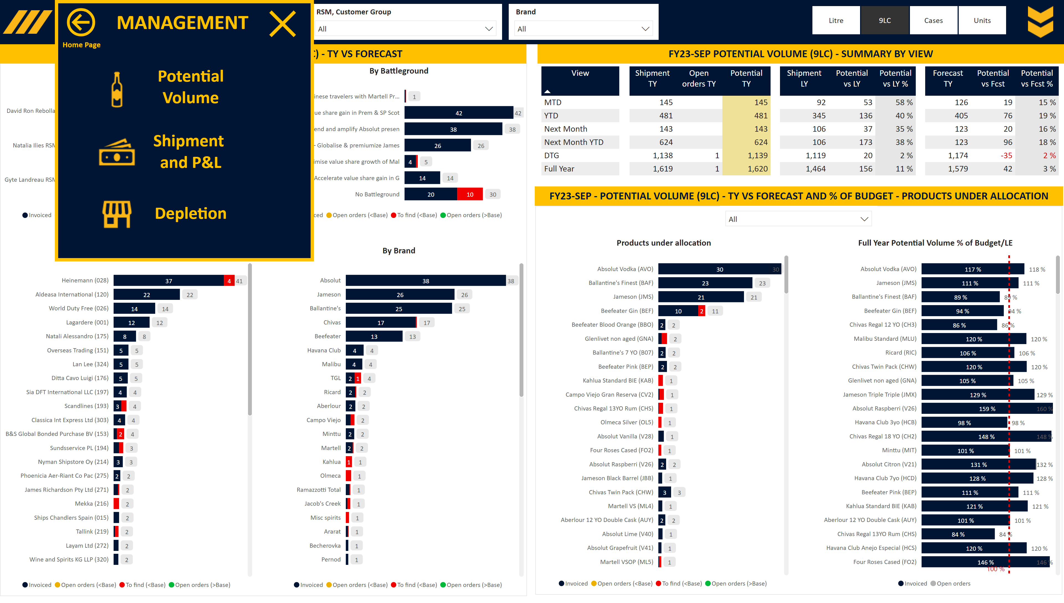
M_Order
Notes:
Image Open
No alt text provided
Slicer RSM, Customer Group
No alt text provided
Slicer Units
No alt text provided
Slicer Base
No alt text provided
Slicer Brand
No alt text provided
Slicer View
No alt text provided
Image Menu
No alt text provided
Area
No alt text provided
image
No alt text provided
slicer
No alt text provided
slicer
No alt text provided
slicer
No alt text provided
shape
No alt text provided
shape
No alt text provided
textbox
No alt text provided
By Brand
No alt text provided
By Battleground
No alt text provided
By Customer
No alt text provided
By RSM
No alt text provided
Title Card
No alt text provided
Title Card
No alt text provided
tableEx
No alt text provided
textbox
No alt text provided
Full Year Potential Volume % of Budget/LE
No alt text provided
Products under allocation
No alt text provided
Slicer Product
No alt text provided
Title Card
No alt text provided
Closing box 2
No alt text provided
shape
No alt text provided
shape
No alt text provided
shape
No alt text provided
Personae Text
No alt text provided
Home Page Button
No alt text provided
Home Page Text
No alt text provided
Closing box 1
No alt text provided
Depletions Text
No alt text provided
Depletions Image
No alt text provided
Actuals Text
No alt text provided
Actuals Image
No alt text provided
Portfolio Text
No alt text provided
Portfolio Image
No alt text provided
Closing box 3
No alt text provided
Area
No alt text provided

Slide 4
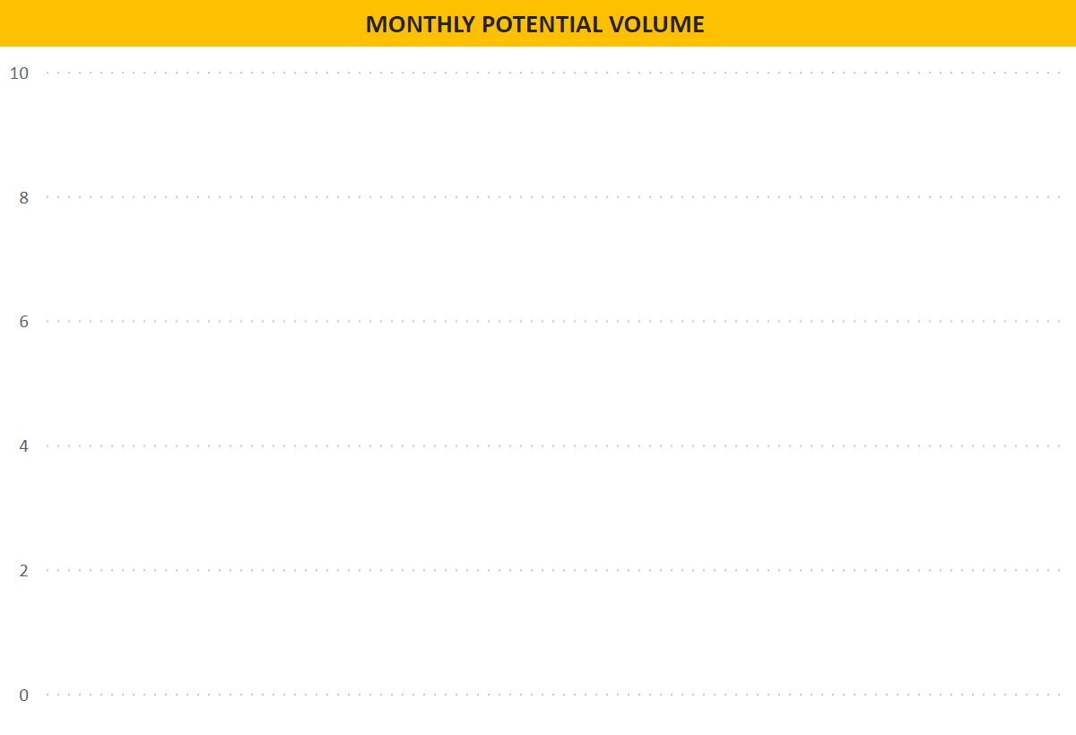
M_Order Tooltip
Notes:
Title Card
No alt text provided
slicer
No alt text provided
Monthly Potential
No alt text provided

Slide 5
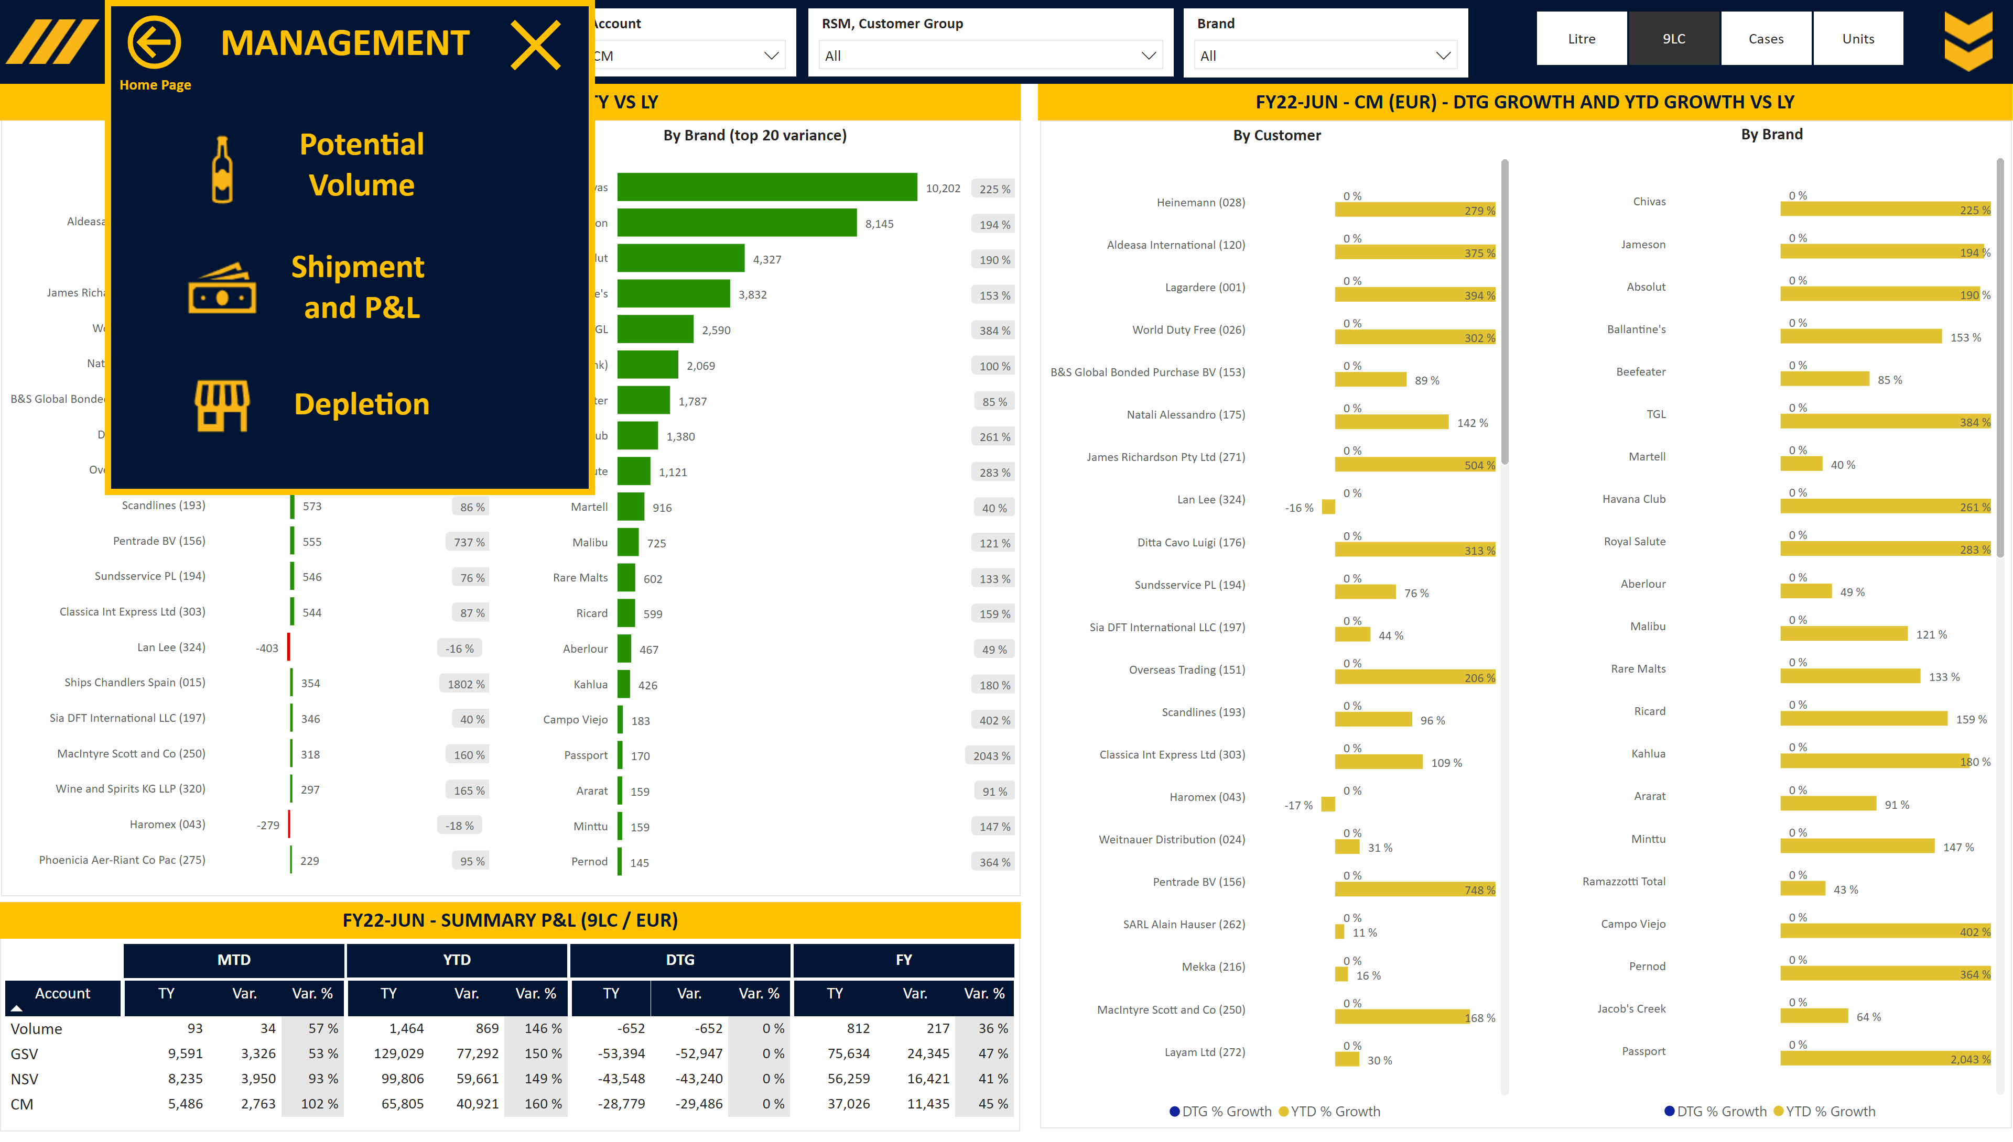
M_Shipment
Notes:
Slicer RSM, Customer Group
No alt text provided
Slicer Brand
No alt text provided
Slicer Units
No alt text provided
Image Open
No alt text provided
Slicer Account
No alt text provided
Slicer Base
No alt text provided
Slicer View
No alt text provided
Image Menu
No alt text provided
Area
No alt text provided
slicer
No alt text provided
image
No alt text provided
slicer
No alt text provided
slicer
No alt text provided
slicer
No alt text provided
shape
No alt text provided
shape
No alt text provided
textbox
No alt text provided
%
No alt text provided
By Customer (top 20 variance)
No alt text provided
%
No alt text provided
By Brand (top 20 variance)
No alt text provided
Title Card
No alt text provided
pivotTable
No alt text provided
Title Card
No alt text provided
Title MTD
No alt text provided
Title YTD
No alt text provided
Title DTG
No alt text provided
textbox
No alt text provided
Title FY
No alt text provided
By Brand
No alt text provided
textbox
No alt text provided
By Customer
No alt text provided
Title Card
No alt text provided
Closing box 2
No alt text provided
shape
No alt text provided
shape
No alt text provided
shape
No alt text provided
Personae Text
No alt text provided
Home Page Button
No alt text provided
Home Page Text
No alt text provided
Closing box 1
No alt text provided
Depletions Text
No alt text provided
Depletions Image
No alt text provided
Actuals Text
No alt text provided
Actuals Image
No alt text provided
Portfolio Text
No alt text provided
Portfolio Image
No alt text provided
Closing box 3
No alt text provided
Area
No alt text provided

Slide 6
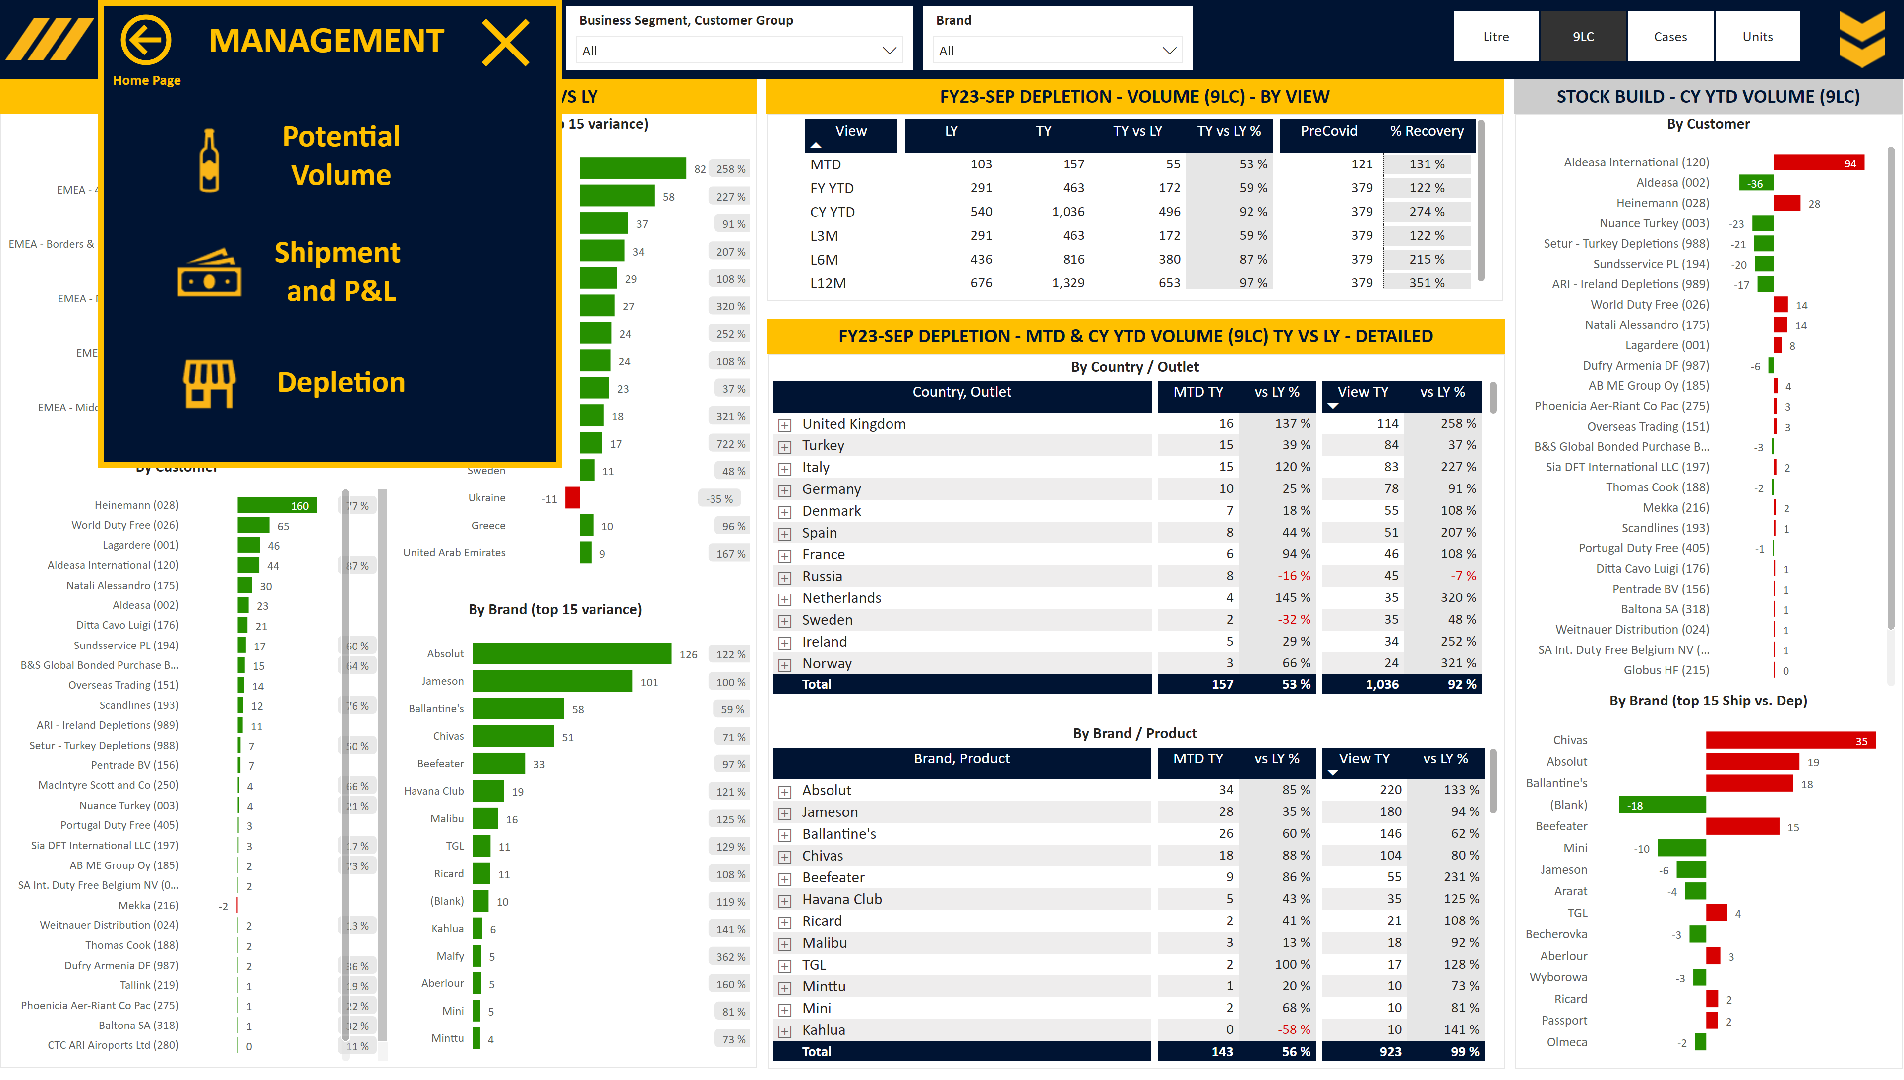
M_Depletion
Notes:
Slicer Units
No alt text provided
Image Open
No alt text provided
Slicer RSM, Customer Group
No alt text provided
Slicer Brand
No alt text provided
Slicer View
No alt text provided
Image Menu
No alt text provided
Area
No alt text provided
slicer
No alt text provided
image
No alt text provided
slicer
No alt text provided
slicer
No alt text provided
slicer
No alt text provided
shape
No alt text provided
shape
No alt text provided
%
No alt text provided
By Brand (top 15 variance)
No alt text provided
%
No alt text provided
By Country (top 15 variance)
No alt text provided
%
No alt text provided
textbox
No alt text provided
%
No alt text provided
By Customer
No alt text provided
By Business Segment
No alt text provided
Title Card
No alt text provided
pivotTable
No alt text provided
textbox
No alt text provided
Title Card
No alt text provided
textbox
No alt text provided
By Brand / Product
No alt text provided
By Country / Outlet
No alt text provided
Title Card
No alt text provided
Closing box 2
No alt text provided
shape
No alt text provided
shape
No alt text provided
shape
No alt text provided
Personae Text
No alt text provided
Home Page Button
No alt text provided
Home Page Text
No alt text provided
Closing box 1
No alt text provided
Depletions Text
No alt text provided
Depletions Image
No alt text provided
Actuals Text
No alt text provided
Actuals Image
No alt text provided
Portfolio Text
No alt text provided
Portfolio Image
No alt text provided
Closing box 3
No alt text provided
Area
No alt text provided
By Brand (top 15 Ship vs. Dep)
No alt text provided
Title Card
No alt text provided
By Customer
No alt text provided
textbox
No alt text provided

Slide 7
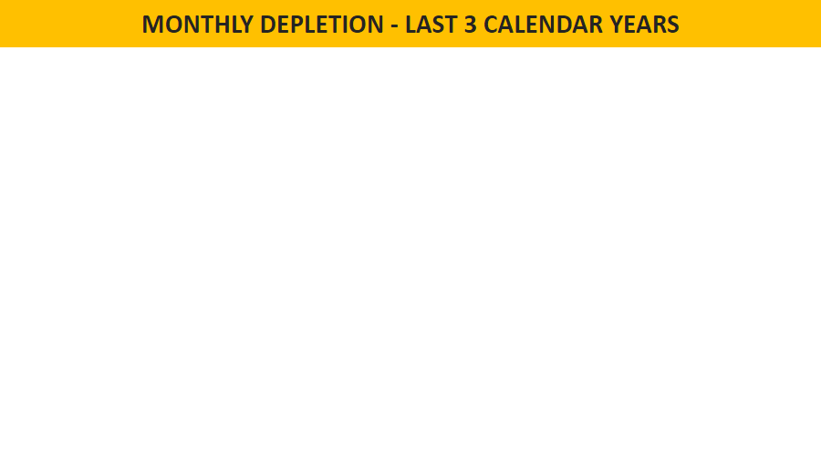
M_Depletion Tooltip
Notes:
Monthly Depletion
No alt text provided
Title Card
No alt text provided
slicer
No alt text provided

Slide 8
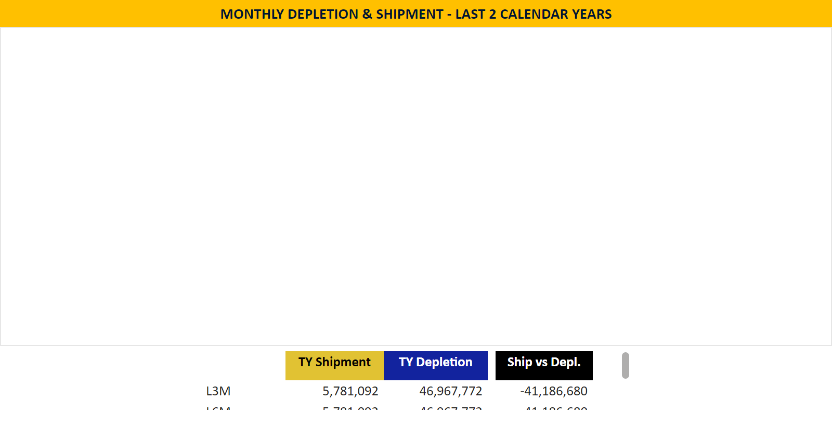
M_Depletion Tooltip Stock
Notes:
slicer
No alt text provided
Monthly Depletion
No alt text provided
Title Card
No alt text provided
Overview (all views)
No alt text provided

Slide 9
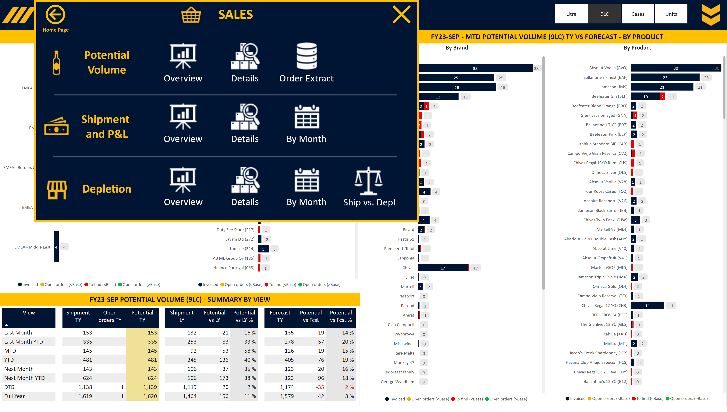
S_Order Overview
Notes:
Image Open
No alt text provided
Slicer Units
No alt text provided
Slicer Base
No alt text provided
Slicer View
No alt text provided
Slicer RSM KAM
No alt text provided
Image Menu
No alt text provided
Area
No alt text provided
image
No alt text provided
slicer
No alt text provided
slicer
No alt text provided
slicer
No alt text provided
slicer
No alt text provided
slicer
No alt text provided
shape
No alt text provided
shape
No alt text provided
textbox
No alt text provided
By Customer
No alt text provided
By Aggregated Customer
No alt text provided
Title Card
No alt text provided
Title Card
No alt text provided
textbox
No alt text provided
tableEx
No alt text provided
Closing box 2
No alt text provided
Personae Text
No alt text provided
Home Page Text
No alt text provided
Home Page Button
No alt text provided
Personae Image
No alt text provided
Closing box 1
No alt text provided
Details Text
No alt text provided
Ship vs Depl Image
No alt text provided
Overview Text
No alt text provided
Ship vs Depl Text
No alt text provided
Details Image
No alt text provided
Depletions Text
No alt text provided
Overview Image
No alt text provided
Depletions Image
No alt text provided
shape
No alt text provided
By Month Text
No alt text provided
By Month Image
No alt text provided
By Month Text
No alt text provided
By Month Image
No alt text provided
Details Text
No alt text provided
Details Image
No alt text provided
Overview Text
No alt text provided
Overview Image
No alt text provided
Actuals Text
No alt text provided
Overview Image
No alt text provided
Actuals Image
No alt text provided
Overview Text
No alt text provided
Extract Text
No alt text provided
Extract Image
No alt text provided
Details Text
No alt text provided
Details Image
No alt text provided
Portfolio Text
No alt text provided
Portfolio Image
No alt text provided
Closing box 3
No alt text provided
Area
No alt text provided
shape
No alt text provided
textbox
No alt text provided
By Product
No alt text provided
By Brand
No alt text provided
Title Card
No alt text provided

Slide 10
S_Order Overview Tooltip
Notes:
Title Card
No alt text provided
slicer
No alt text provided
Monthly Potential
No alt text provided

Slide 11
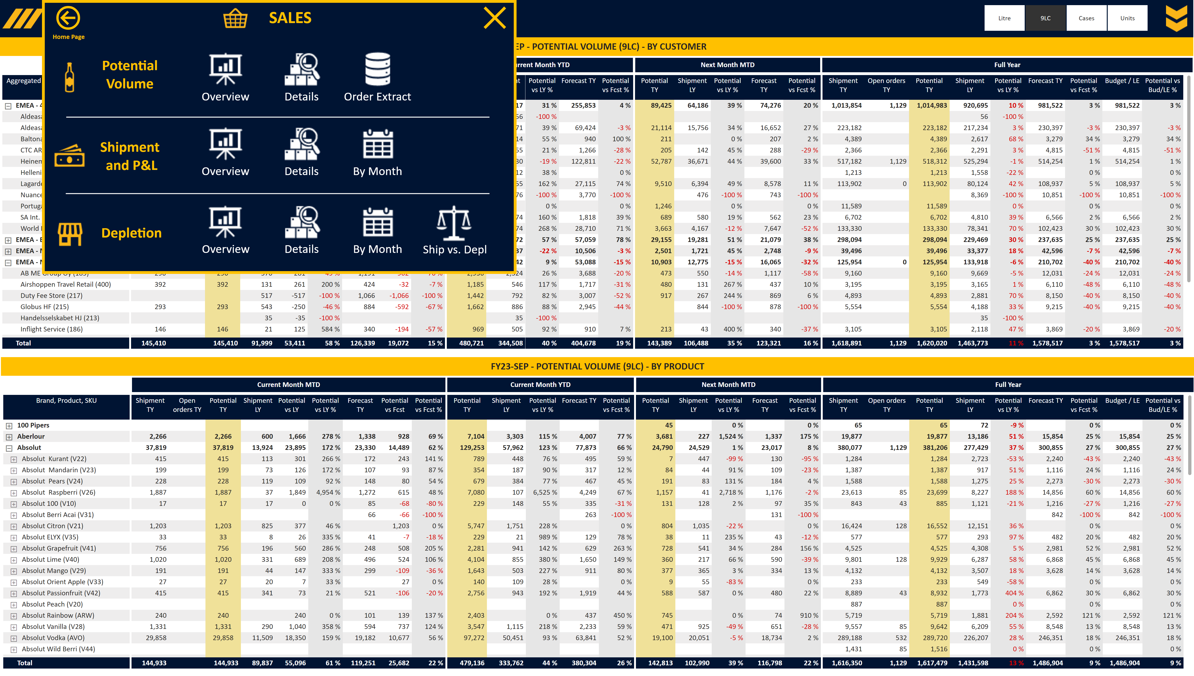
S_Order Detailed
Notes:
Slicer Units
No alt text provided
Image Open
No alt text provided
Image Menu
No alt text provided
Slicer RSM KAM
No alt text provided
Slicer Period
No alt text provided
Area
No alt text provided
Title Table
No alt text provided
Title MTD
No alt text provided
Title YTD
No alt text provided
Title NM MTD
No alt text provided
Title FY
No alt text provided
pivotTable
No alt text provided
Title Table
No alt text provided
Title MTD
No alt text provided
Title YTD
No alt text provided
Title NM MTD
No alt text provided
Title FY
No alt text provided
pivotTable
No alt text provided
image
No alt text provided
slicer
No alt text provided
slicer
No alt text provided
slicer
No alt text provided
slicer
No alt text provided
shape
No alt text provided
shape
No alt text provided
Closing box 2
No alt text provided
Personae Text
No alt text provided
Home Page Text
No alt text provided
Home Page Button
No alt text provided
Personae Image
No alt text provided
Closing box 1
No alt text provided
Details Text
No alt text provided
Ship vs Depl Image
No alt text provided
Overview Text
No alt text provided
Ship vs Depl Text
No alt text provided
Details Image
No alt text provided
Depletions Text
No alt text provided
Overview Image
No alt text provided
Depletions Image
No alt text provided
shape
No alt text provided
By Month Text
No alt text provided
By Month Image
No alt text provided
By Month Text
No alt text provided
By Month Image
No alt text provided
Details Text
No alt text provided
Details Image
No alt text provided
Overview Text
No alt text provided
Overview Image
No alt text provided
Actuals Text
No alt text provided
Overview Image
No alt text provided
Actuals Image
No alt text provided
Overview Text
No alt text provided
Extract Text
No alt text provided
Extract Image
No alt text provided
Details Text
No alt text provided
Details Image
No alt text provided
Portfolio Text
No alt text provided
Portfolio Image
No alt text provided
Closing box 3
No alt text provided
Area
No alt text provided
shape
No alt text provided

Slide 12
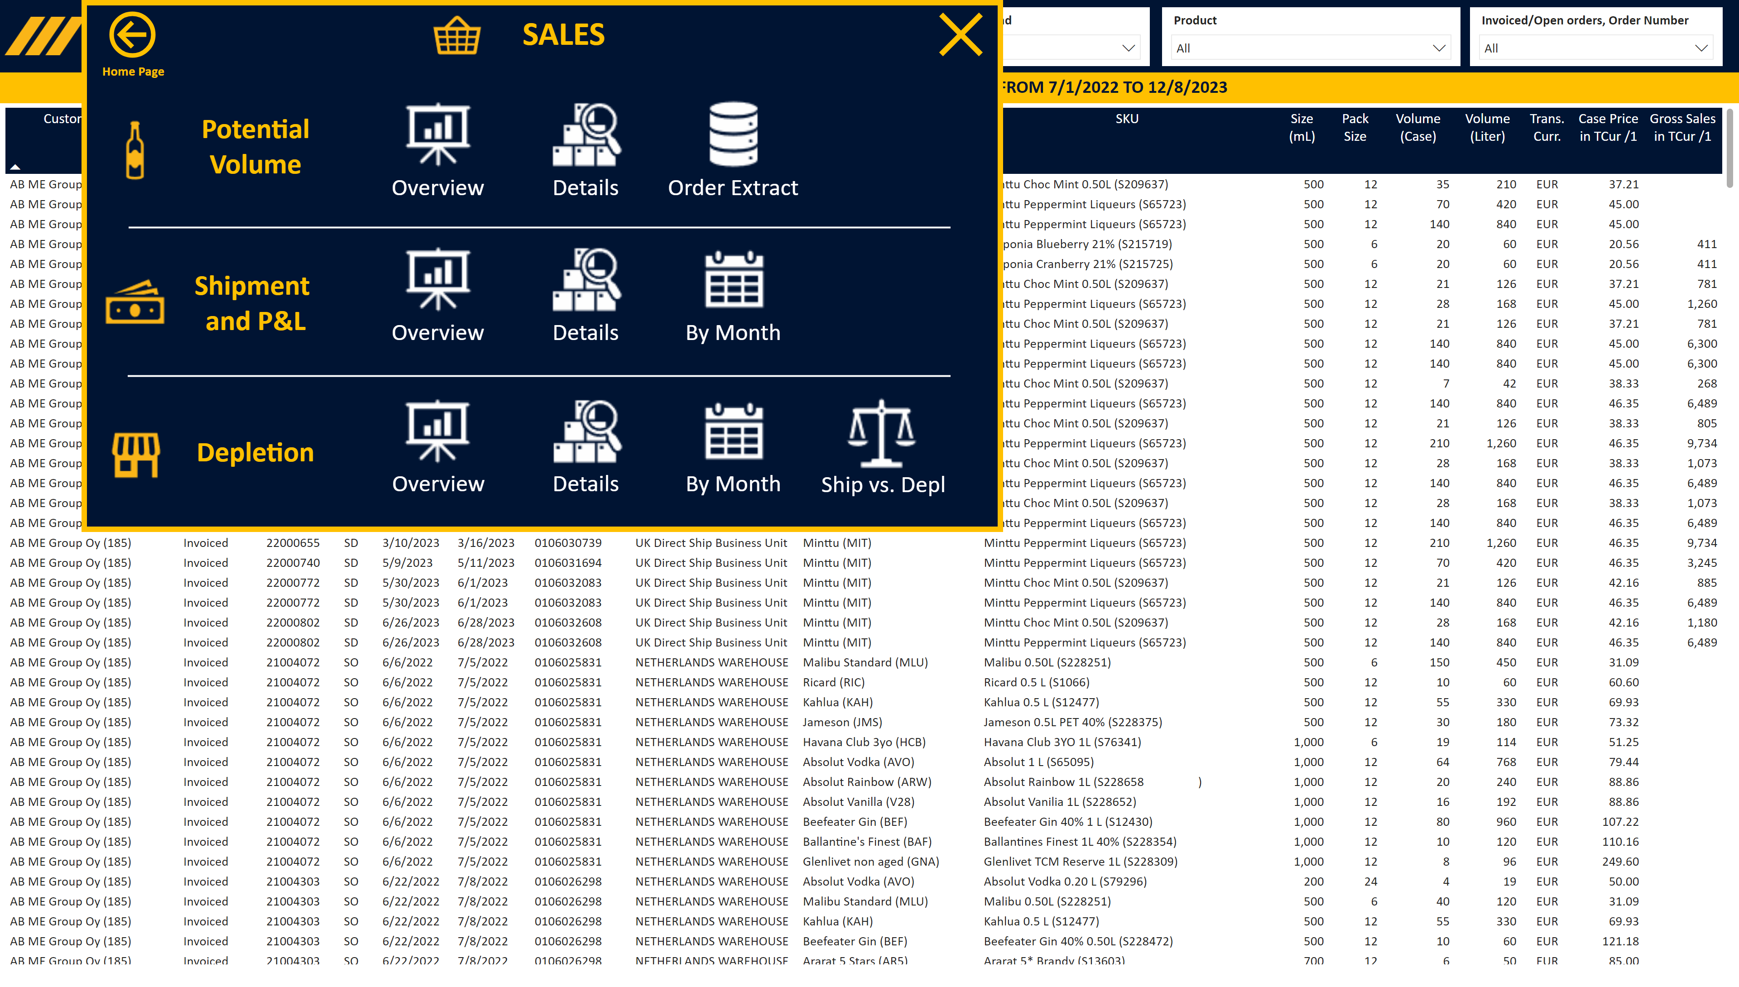
S_Order Extract
Notes:
Slicer Aggregated Customer, Customer Group
No alt text provided
Slicer Brand, Sub Brand
No alt text provided
Slicer Product
No alt text provided
Image Open
No alt text provided
Slicer Period
No alt text provided
Slicer RSM KAM
No alt text provided
Image Menu
No alt text provided
Area
No alt text provided
image
No alt text provided
shape
No alt text provided
shape
No alt text provided
tableEx
No alt text provided
Title Card
No alt text provided
Closing box 2
No alt text provided
Personae Text
No alt text provided
Home Page Text
No alt text provided
Home Page Button
No alt text provided
Personae Image
No alt text provided
Closing box 1
No alt text provided
Details Text
No alt text provided
Ship vs Depl Image
No alt text provided
Overview Text
No alt text provided
Ship vs Depl Text
No alt text provided
Details Image
No alt text provided
Depletions Text
No alt text provided
Overview Image
No alt text provided
Depletions Image
No alt text provided
shape
No alt text provided
By Month Text
No alt text provided
By Month Image
No alt text provided
By Month Text
No alt text provided
By Month Image
No alt text provided
Details Text
No alt text provided
Details Image
No alt text provided
Overview Text
No alt text provided
Overview Image
No alt text provided
Actuals Text
No alt text provided
Overview Image
No alt text provided
Actuals Image
No alt text provided
Overview Text
No alt text provided
Extract Text
No alt text provided
Extract Image
No alt text provided
Details Text
No alt text provided
Details Image
No alt text provided
Portfolio Text
No alt text provided
Portfolio Image
No alt text provided
Closing box 3
No alt text provided
Area
No alt text provided
shape
No alt text provided
Slicer Product
No alt text provided

Slide 13
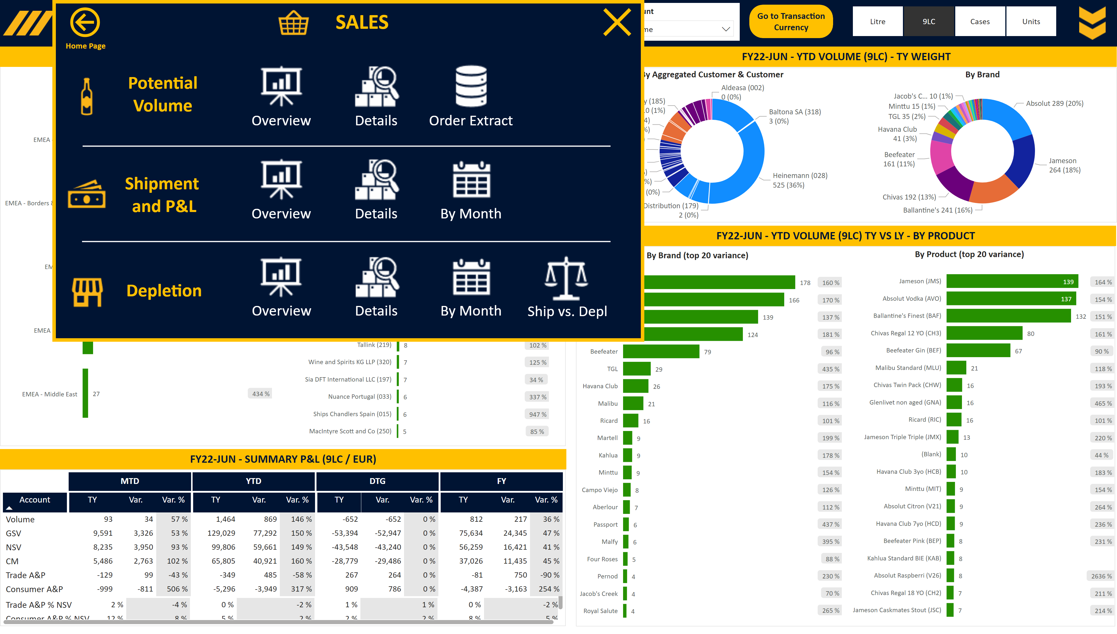
S_Shipment Overview
Notes:
Slicer Units
No alt text provided
Image Open
No alt text provided
shape
No alt text provided
Slicer Account
No alt text provided
Slicer Base
No alt text provided
Slicer View
No alt text provided
Slicer RSM KAM
No alt text provided
Image Menu
No alt text provided
Area
No alt text provided
slicer
No alt text provided
image
No alt text provided
slicer
No alt text provided
slicer
No alt text provided
slicer
No alt text provided
slicer
No alt text provided
slicer
No alt text provided
slicer
No alt text provided
shape
No alt text provided
shape
No alt text provided
By Aggregated Customer & Customer
No alt text provided
Title Card
No alt text provided
textbox
No alt text provided
By Brand
No alt text provided
textbox
No alt text provided
%
No alt text provided
%
No alt text provided
By Customer (top 20 variance)
No alt text provided
By Aggregated Customer
No alt text provided
Title Card
No alt text provided
pivotTable
No alt text provided
Title Card
No alt text provided
Title MTD
No alt text provided
Title YTD
No alt text provided
Title DTG
No alt text provided
pivotTable
No alt text provided
textbox
No alt text provided
Title FY
No alt text provided
%
No alt text provided
textbox
No alt text provided
%
No alt text provided
By Product (top 20 variance)
No alt text provided
By Brand (top 20 variance)
No alt text provided
Title Card
No alt text provided
Closing box 2
No alt text provided
Personae Text
No alt text provided
Home Page Text
No alt text provided
Home Page Button
No alt text provided
Personae Image
No alt text provided
Closing box 1
No alt text provided
Details Text
No alt text provided
Ship vs Depl Image
No alt text provided
Overview Text
No alt text provided
Ship vs Depl Text
No alt text provided
Details Image
No alt text provided
Depletions Text
No alt text provided
Overview Image
No alt text provided
Depletions Image
No alt text provided
shape
No alt text provided
By Month Text
No alt text provided
By Month Image
No alt text provided
By Month Text
No alt text provided
By Month Image
No alt text provided
Details Text
No alt text provided
Details Image
No alt text provided
Overview Text
No alt text provided
Overview Image
No alt text provided
Actuals Text
No alt text provided
Overview Image
No alt text provided
Actuals Image
No alt text provided
Overview Text
No alt text provided
Extract Text
No alt text provided
Extract Image
No alt text provided
Details Text
No alt text provided
Details Image
No alt text provided
Portfolio Text
No alt text provided
Portfolio Image
No alt text provided
Closing box 3
No alt text provided
Area
No alt text provided
shape
No alt text provided

Slide 14
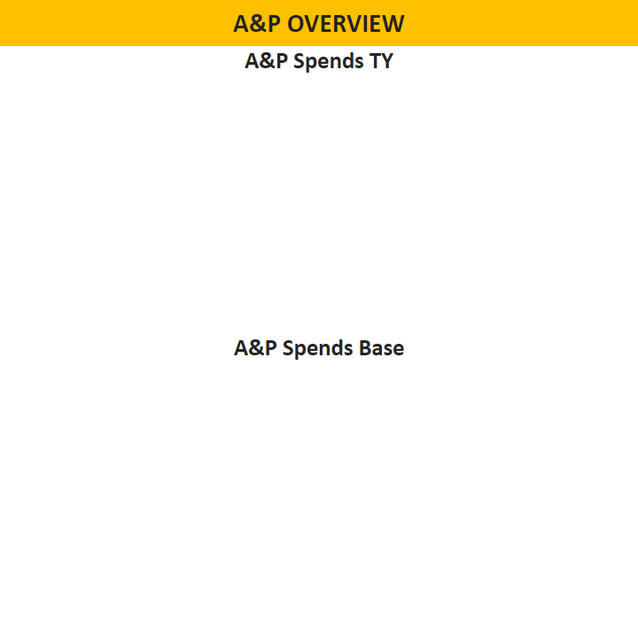
S_Shipment Overview Tooltip
Notes:
Title Table by Customer
No alt text provided
slicer
No alt text provided
A&P Spends TY
No alt text provided
A&P Spends Base
No alt text provided

Slide 15
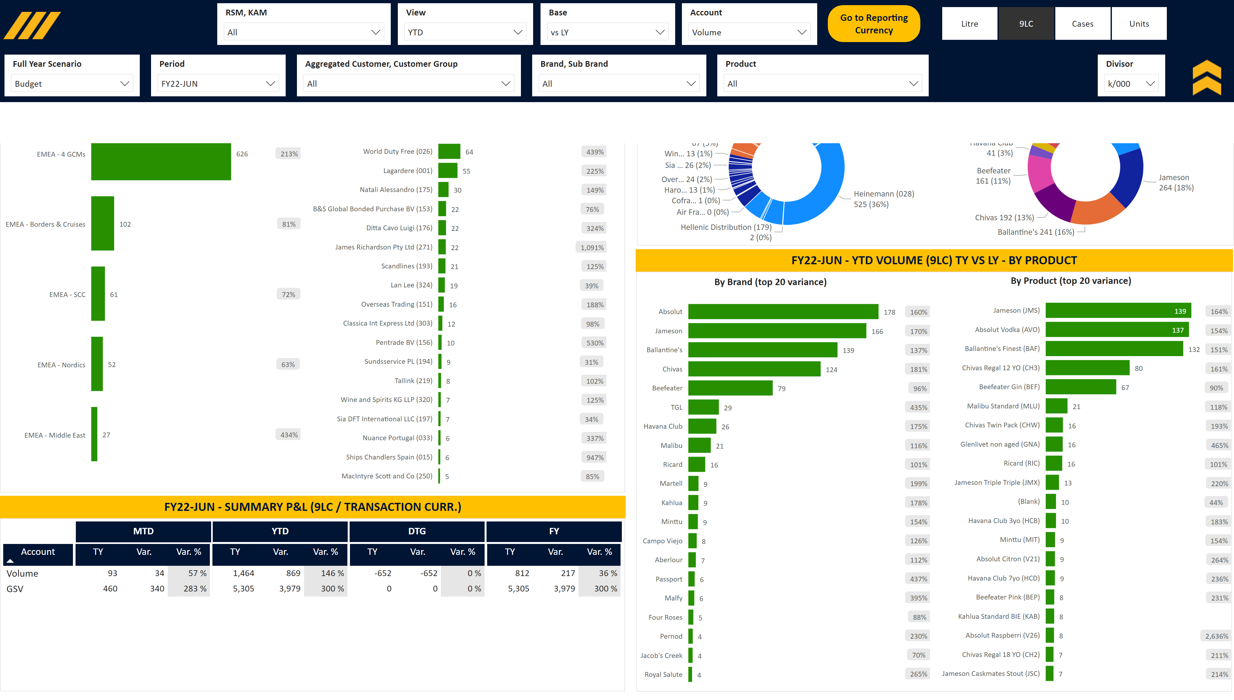
S_Shipment Overview TCur
Notes:
Slicer Units
No alt text provided
image
No alt text provided
shape
No alt text provided
Slicer Account
No alt text provided
Slicer Base
No alt text provided
Slicer View
No alt text provided
Slicer RSM KAM
No alt text provided
Image Menu
No alt text provided
Area
No alt text provided
Slicer Divisor
No alt text provided
Image Close
No alt text provided
Slicer Product
No alt text provided
Slicer Brand, Sub Brand
No alt text provided
Slicer Aggregated Customer, Customer Group
No alt text provided
Slicer Period
No alt text provided
Slicer Full Year
No alt text provided
Area Blank
No alt text provided
Area
No alt text provided
By Aggregated Customer & Customer
No alt text provided
Title Card
No alt text provided
textbox
No alt text provided
By Brand
No alt text provided
textbox
No alt text provided
%
No alt text provided
%
No alt text provided
By Customer (top 20 variance)
No alt text provided
By Aggregated Customer
No alt text provided
Title Card
No alt text provided
pivotTable
No alt text provided
Title Card
No alt text provided
Title MTD
No alt text provided
Title YTD
No alt text provided
Title DTG
No alt text provided
textbox
No alt text provided
Title FY
No alt text provided
%
No alt text provided
textbox
No alt text provided
%
No alt text provided
By Product (top 20 variance)
No alt text provided
By Brand (top 20 variance)
No alt text provided
Title Card
No alt text provided
shape
No alt text provided
textbox
No alt text provided
textbox
No alt text provided
actionButton
No alt text provided
image
No alt text provided
shape
No alt text provided
textbox
No alt text provided
image
No alt text provided
textbox
No alt text provided
textbox
No alt text provided
image
No alt text provided
textbox
No alt text provided
image
No alt text provided
image
No alt text provided
shape
No alt text provided
textbox
No alt text provided
image
No alt text provided
textbox
No alt text provided
image
No alt text provided
textbox
No alt text provided
image
No alt text provided
textbox
No alt text provided
image
No alt text provided
textbox
No alt text provided
image
No alt text provided
image
No alt text provided
textbox
No alt text provided
textbox
No alt text provided
image
No alt text provided
textbox
No alt text provided
image
No alt text provided
textbox
No alt text provided
image
No alt text provided
shape
No alt text provided
shape
No alt text provided
shape
No alt text provided

Slide 16
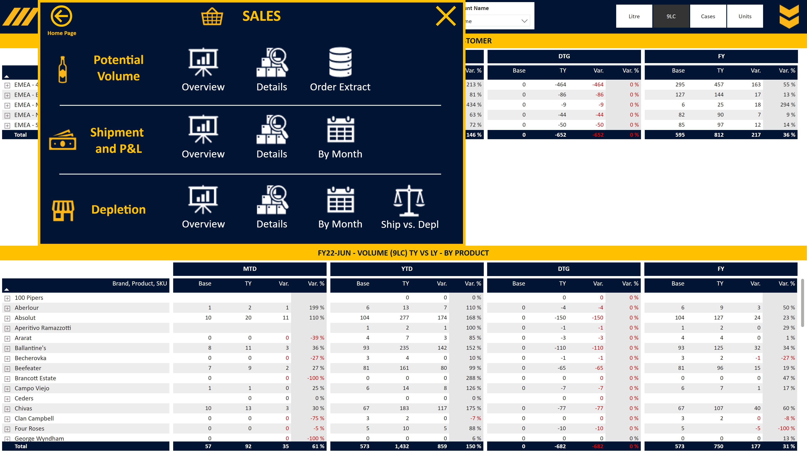
S_Shipment Detailed
Notes:
Title Card
No alt text provided
Title MTD
No alt text provided
Title YTD
No alt text provided
Title DTG
No alt text provided
Title Full Year
No alt text provided
pivotTable
No alt text provided
Slicer Units
No alt text provided
Image Open
No alt text provided
Slicer Base
No alt text provided
Slicer Account
No alt text provided
Slicer RSM KAM
No alt text provided
Image Menu
No alt text provided
Area
No alt text provided
image
No alt text provided
slicer
No alt text provided
slicer
No alt text provided
slicer
No alt text provided
slicer
No alt text provided
slicer
No alt text provided
slicer
No alt text provided
slicer
No alt text provided
shape
No alt text provided
shape
No alt text provided
Title Card
No alt text provided
Title MTD
No alt text provided
Title YTD
No alt text provided
Title DTG
No alt text provided
Title Full Year
No alt text provided
pivotTable
No alt text provided
Closing box 2
No alt text provided
Personae Text
No alt text provided
Home Page Text
No alt text provided
Home Page Button
No alt text provided
Personae Image
No alt text provided
Closing box 1
No alt text provided
Details Text
No alt text provided
Ship vs Depl Image
No alt text provided
Overview Text
No alt text provided
Ship vs Depl Text
No alt text provided
Details Image
No alt text provided
Depletions Text
No alt text provided
Overview Image
No alt text provided
Depletions Image
No alt text provided
shape
No alt text provided
By Month Text
No alt text provided
By Month Image
No alt text provided
By Month Text
No alt text provided
By Month Image
No alt text provided
Details Text
No alt text provided
Details Image
No alt text provided
Overview Text
No alt text provided
Overview Image
No alt text provided
Actuals Text
No alt text provided
Overview Image
No alt text provided
Actuals Image
No alt text provided
Overview Text
No alt text provided
Extract Text
No alt text provided
Extract Image
No alt text provided
Details Text
No alt text provided
Details Image
No alt text provided
Portfolio Text
No alt text provided
Portfolio Image
No alt text provided
Closing box 3
No alt text provided
Area
No alt text provided
shape
No alt text provided

Slide 17
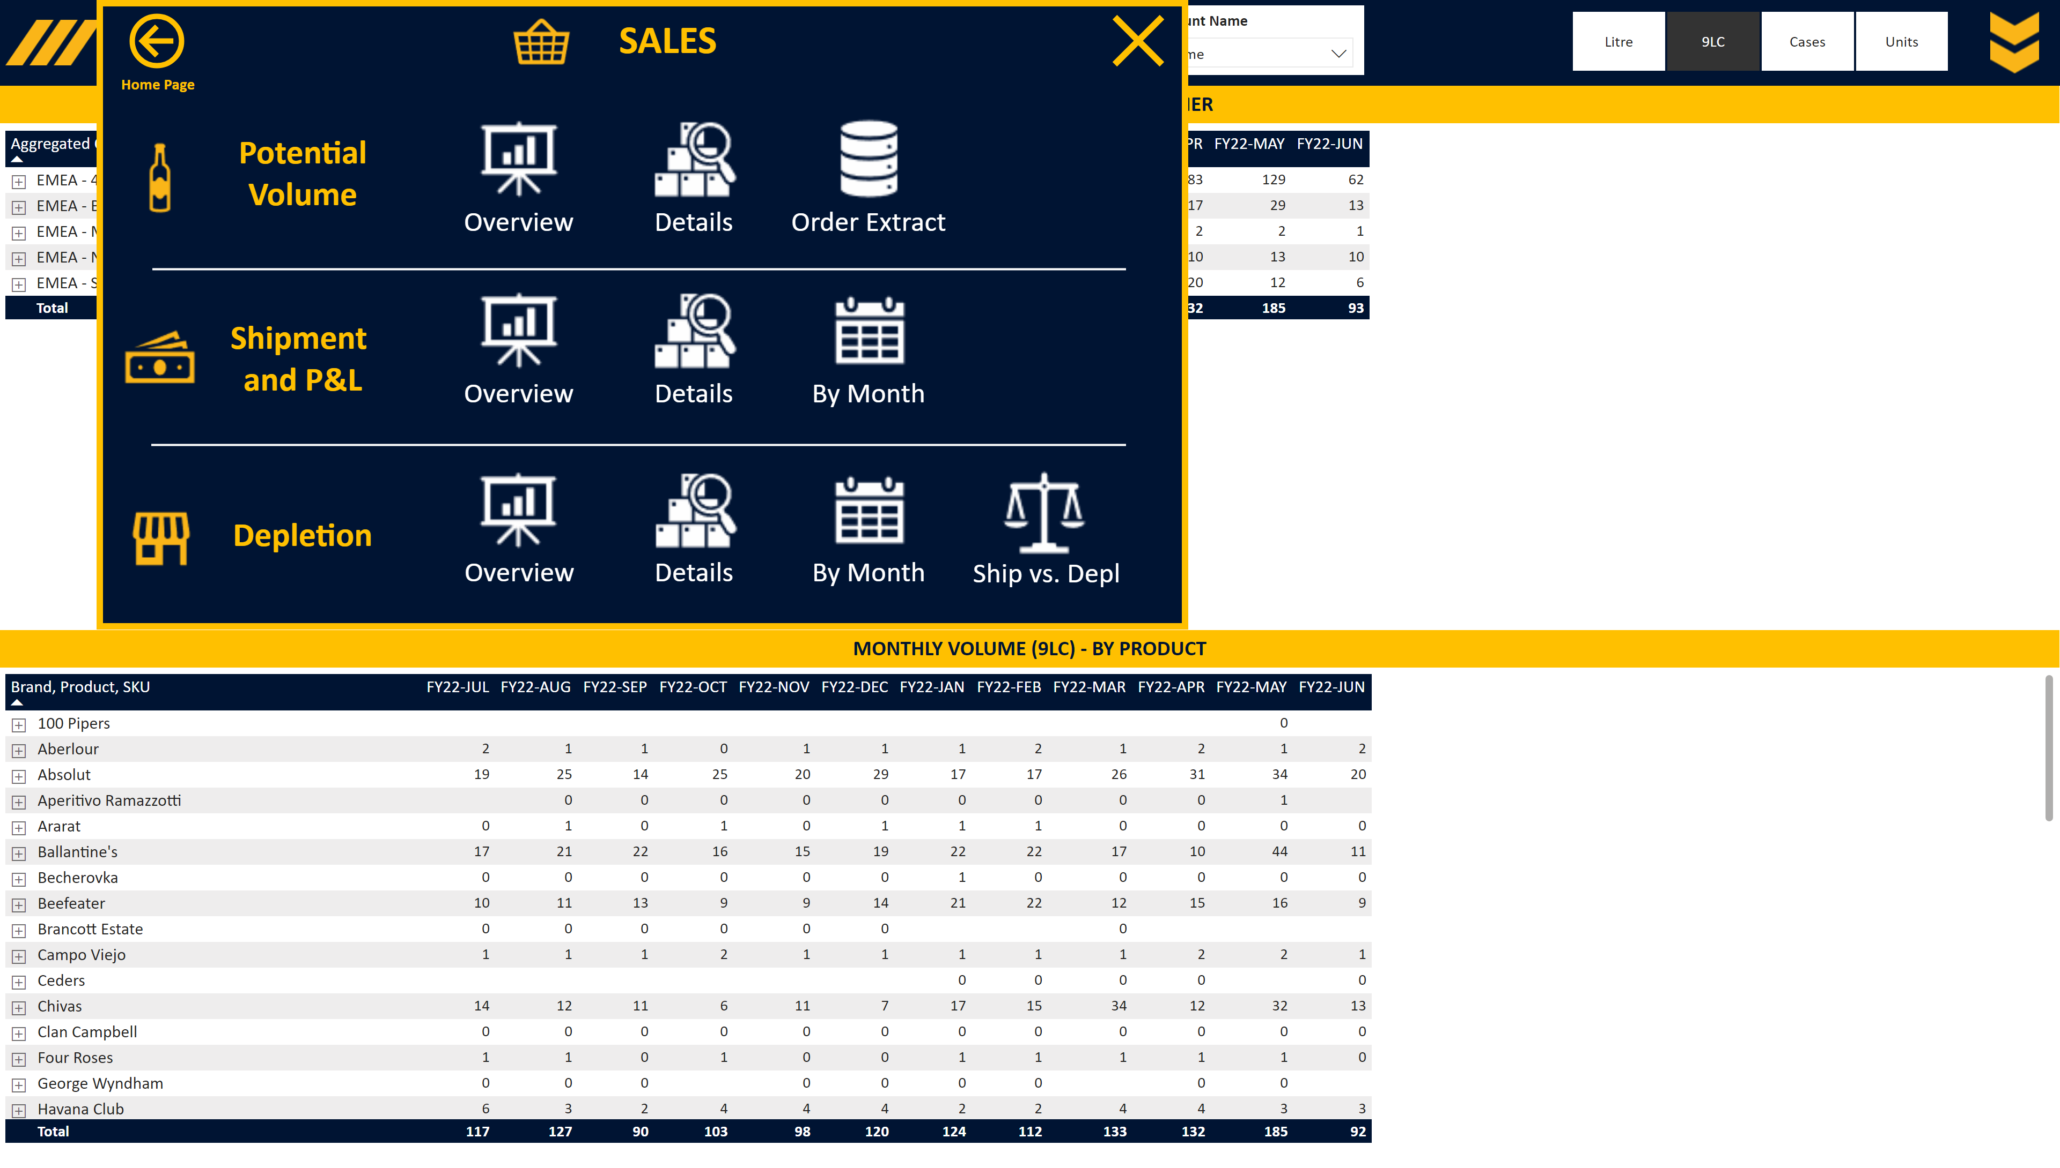
S_Shipment by Month
Notes:
Slicer Units
No alt text provided
Image Open
No alt text provided
Slicer Period
No alt text provided
Slicer Account
No alt text provided
Slicer RSM KAM
No alt text provided
Image Menu
No alt text provided
Area
No alt text provided
image
No alt text provided
slicer
No alt text provided
slicer
No alt text provided
slicer
No alt text provided
slicer
No alt text provided
slicer
No alt text provided
shape
No alt text provided
shape
No alt text provided
Title Card
No alt text provided
pivotTable
No alt text provided
Title Card
No alt text provided
pivotTable
No alt text provided
Closing box 2
No alt text provided
Personae Text
No alt text provided
Home Page Text
No alt text provided
Home Page Button
No alt text provided
Personae Image
No alt text provided
Closing box 1
No alt text provided
Details Text
No alt text provided
Ship vs Depl Image
No alt text provided
Overview Text
No alt text provided
Ship vs Depl Text
No alt text provided
Details Image
No alt text provided
Depletions Text
No alt text provided
Overview Image
No alt text provided
Depletions Image
No alt text provided
shape
No alt text provided
By Month Text
No alt text provided
By Month Image
No alt text provided
By Month Text
No alt text provided
By Month Image
No alt text provided
Details Text
No alt text provided
Details Image
No alt text provided
Overview Text
No alt text provided
Overview Image
No alt text provided
Actuals Text
No alt text provided
Overview Image
No alt text provided
Actuals Image
No alt text provided
Overview Text
No alt text provided
Extract Text
No alt text provided
Extract Image
No alt text provided
Details Text
No alt text provided
Details Image
No alt text provided
Portfolio Text
No alt text provided
Portfolio Image
No alt text provided
Closing box 3
No alt text provided
Area
No alt text provided
shape
No alt text provided

Slide 18
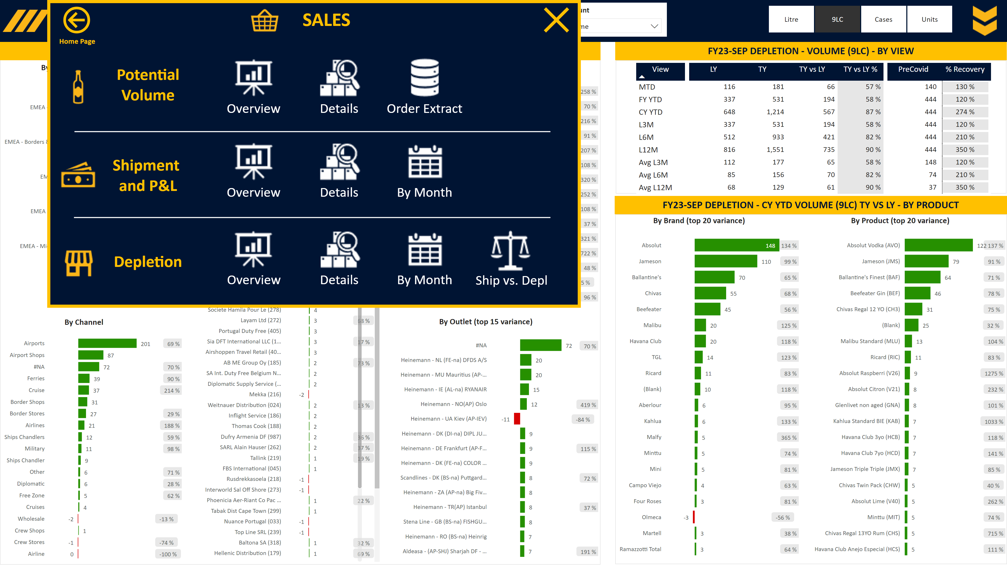
S_Depletion Overview
Notes:
Slicer Units
No alt text provided
Image Open
No alt text provided
Slicer Account
No alt text provided
Slicer View
No alt text provided
Slicer RSM KAM
No alt text provided
Image Menu
No alt text provided
Area
No alt text provided
slicer
No alt text provided
slicer
No alt text provided
slicer
No alt text provided
slicer
No alt text provided
slicer
No alt text provided
image
No alt text provided
slicer
No alt text provided
slicer
No alt text provided
slicer
No alt text provided
slicer
No alt text provided
slicer
No alt text provided
shape
No alt text provided
shape
No alt text provided
textbox
No alt text provided
%
No alt text provided
By Outlet (top 15 variance)
No alt text provided
%
No alt text provided
By Country (top 15 variance)
No alt text provided
%
No alt text provided
By Customer
No alt text provided
%
No alt text provided
By Channel
No alt text provided
%
No alt text provided
By Aggregated Customer
No alt text provided
Title Card
No alt text provided
textbox
No alt text provided
pivotTable
No alt text provided
Title Card
No alt text provided
textbox
No alt text provided
%
No alt text provided
By Product (top 20 variance)
No alt text provided
%
No alt text provided
By Brand (top 20 variance)
No alt text provided
Title Card
No alt text provided
Closing box 2
No alt text provided
Personae Text
No alt text provided
Home Page Text
No alt text provided
Home Page Button
No alt text provided
Personae Image
No alt text provided
Closing box 1
No alt text provided
Details Text
No alt text provided
Ship vs Depl Image
No alt text provided
Overview Text
No alt text provided
Ship vs Depl Text
No alt text provided
Details Image
No alt text provided
Depletions Text
No alt text provided
Overview Image
No alt text provided
Depletions Image
No alt text provided
shape
No alt text provided
By Month Text
No alt text provided
By Month Image
No alt text provided
By Month Text
No alt text provided
By Month Image
No alt text provided
Details Text
No alt text provided
Details Image
No alt text provided
Overview Text
No alt text provided
Overview Image
No alt text provided
Actuals Text
No alt text provided
Overview Image
No alt text provided
Actuals Image
No alt text provided
Overview Text
No alt text provided
Extract Text
No alt text provided
Extract Image
No alt text provided
Details Text
No alt text provided
Details Image
No alt text provided
Portfolio Text
No alt text provided
Portfolio Image
No alt text provided
Closing box 3
No alt text provided
Area
No alt text provided
shape
No alt text provided

Slide 19
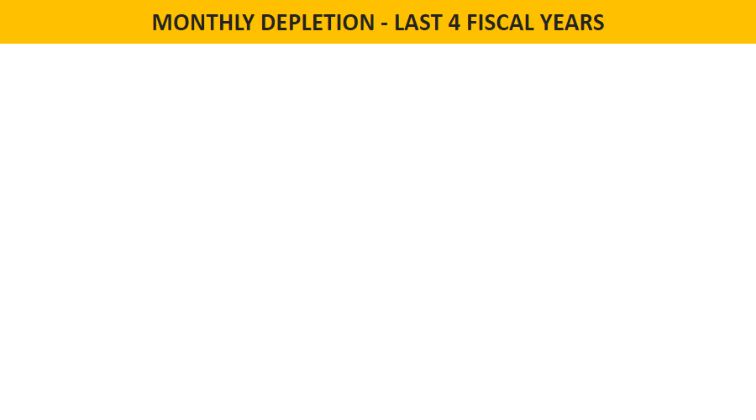
S_Depletion Overview Tooltip
Notes:
Monthly Depletion
No alt text provided
Title Card
No alt text provided
slicer
No alt text provided

Slide 20

S_Depletion Overview Tooltip SKU
Notes:
Monthly Depletion
No alt text provided
Title Card
No alt text provided
slicer
No alt text provided

Slide 21
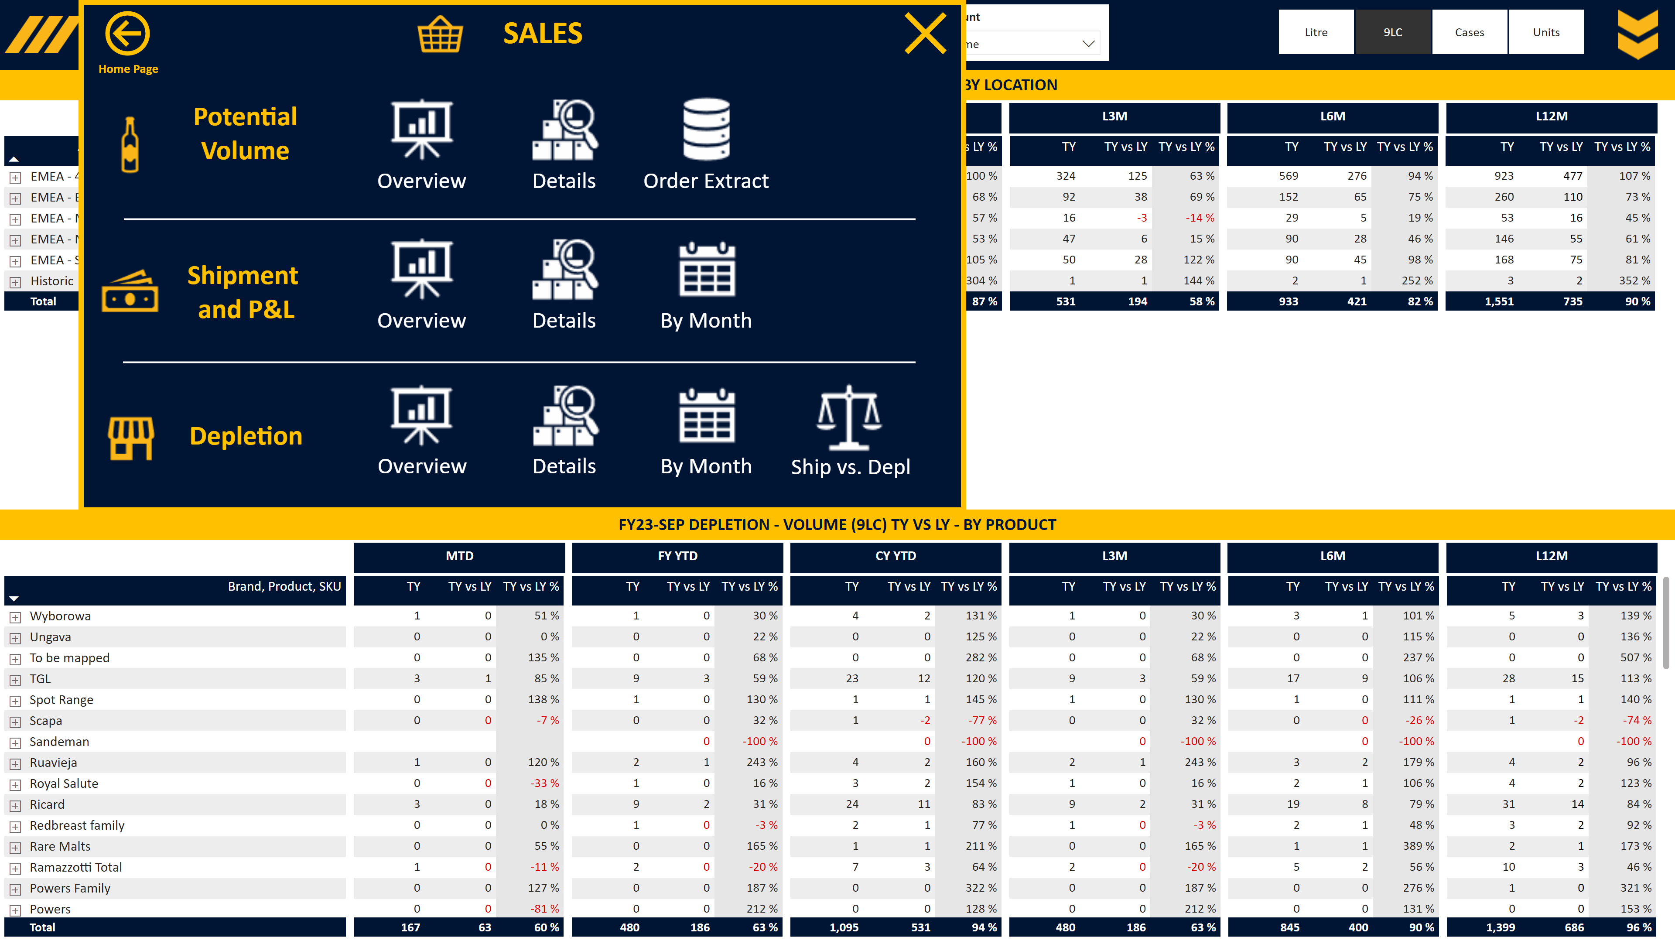
S_Depletion Detailed
Notes:
Slicer Units
No alt text provided
Image Open
No alt text provided
Slicer Account
No alt text provided
Slicer RSM KAM
No alt text provided
Image Menu
No alt text provided
Area
No alt text provided
slicer
No alt text provided
slicer
No alt text provided
slicer
No alt text provided
slicer
No alt text provided
image
No alt text provided
slicer
No alt text provided
slicer
No alt text provided
slicer
No alt text provided
slicer
No alt text provided
slicer
No alt text provided
slicer
No alt text provided
shape
No alt text provided
shape
No alt text provided
Title Card
No alt text provided
Title CY YTD
No alt text provided
Title FY YTD
No alt text provided
Title MTD
No alt text provided
Title L3M
No alt text provided
Title L6M
No alt text provided
Title L12M
No alt text provided
pivotTable
No alt text provided
Title Card
No alt text provided
Title CY YTD
No alt text provided
Title FY YTD
No alt text provided
Title MTD
No alt text provided
Title L3M
No alt text provided
Title L6M
No alt text provided
Title L12M
No alt text provided
pivotTable
No alt text provided
Closing box 2
No alt text provided
Personae Text
No alt text provided
Home Page Text
No alt text provided
Home Page Button
No alt text provided
Personae Image
No alt text provided
Closing box 1
No alt text provided
Details Text
No alt text provided
Ship vs Depl Image
No alt text provided
Overview Text
No alt text provided
Ship vs Depl Text
No alt text provided
Details Image
No alt text provided
Depletions Text
No alt text provided
Overview Image
No alt text provided
Depletions Image
No alt text provided
shape
No alt text provided
By Month Text
No alt text provided
By Month Image
No alt text provided
By Month Text
No alt text provided
By Month Image
No alt text provided
Details Text
No alt text provided
Details Image
No alt text provided
Overview Text
No alt text provided
Overview Image
No alt text provided
Actuals Text
No alt text provided
Overview Image
No alt text provided
Actuals Image
No alt text provided
Overview Text
No alt text provided
Extract Text
No alt text provided
Extract Image
No alt text provided
Details Text
No alt text provided
Details Image
No alt text provided
Portfolio Text
No alt text provided
Portfolio Image
No alt text provided
Closing box 3
No alt text provided
Area
No alt text provided
shape
No alt text provided

Slide 22
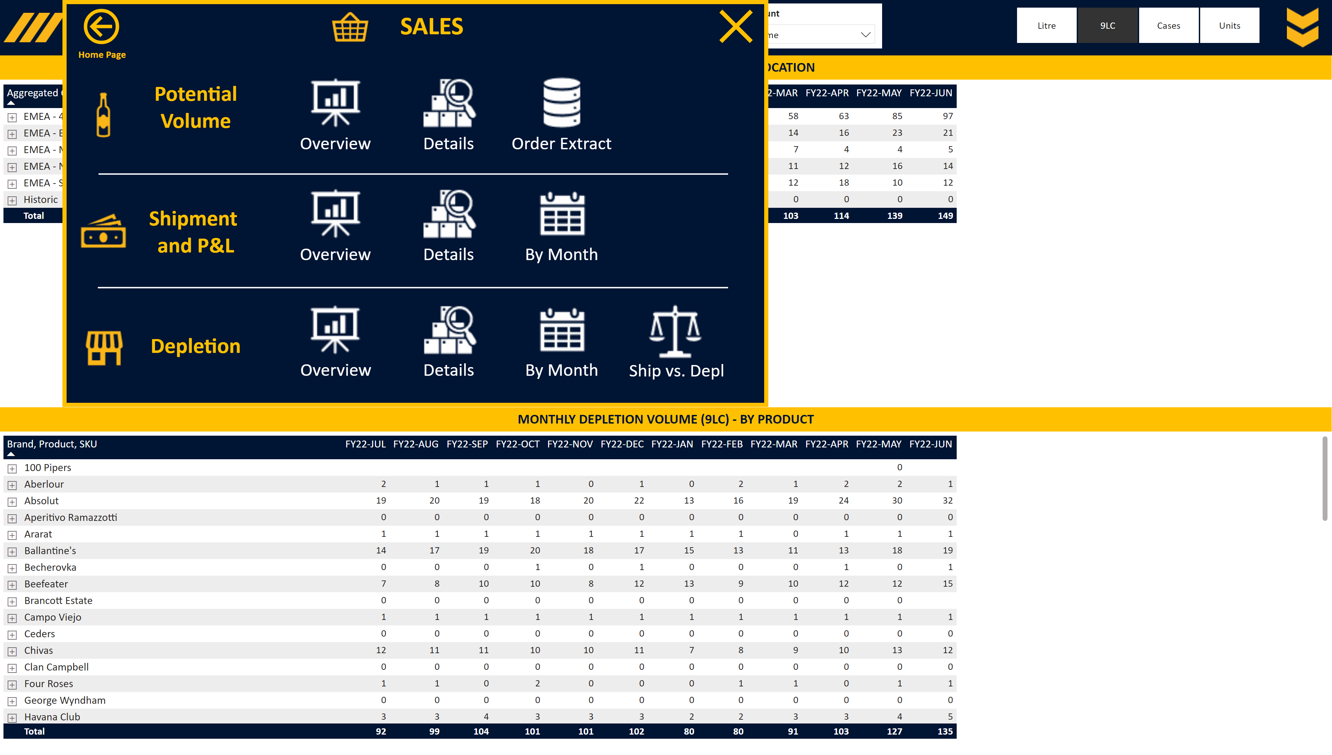
S_Depletion by Month
Notes:
Slicer Units
No alt text provided
Image Open
No alt text provided
Slicer Account
No alt text provided
Slicer RSM KAM
No alt text provided
Slicer Period
No alt text provided
Image Menu
No alt text provided
Area
No alt text provided
slicer
No alt text provided
slicer
No alt text provided
slicer
No alt text provided
slicer
No alt text provided
slicer
No alt text provided
image
No alt text provided
slicer
No alt text provided
slicer
No alt text provided
slicer
No alt text provided
slicer
No alt text provided
shape
No alt text provided
shape
No alt text provided
Title Card
No alt text provided
pivotTable
No alt text provided
Title Card
No alt text provided
pivotTable
No alt text provided
Closing box 2
No alt text provided
Personae Text
No alt text provided
Home Page Text
No alt text provided
Home Page Button
No alt text provided
Personae Image
No alt text provided
Closing box 1
No alt text provided
Details Text
No alt text provided
Ship vs Depl Image
No alt text provided
Overview Text
No alt text provided
Ship vs Depl Text
No alt text provided
Details Image
No alt text provided
Depletions Text
No alt text provided
Overview Image
No alt text provided
Depletions Image
No alt text provided
shape
No alt text provided
By Month Text
No alt text provided
By Month Image
No alt text provided
By Month Text
No alt text provided
By Month Image
No alt text provided
Details Text
No alt text provided
Details Image
No alt text provided
Overview Text
No alt text provided
Overview Image
No alt text provided
Actuals Text
No alt text provided
Overview Image
No alt text provided
Actuals Image
No alt text provided
Overview Text
No alt text provided
Extract Text
No alt text provided
Extract Image
No alt text provided
Details Text
No alt text provided
Details Image
No alt text provided
Portfolio Text
No alt text provided
Portfolio Image
No alt text provided
Closing box 3
No alt text provided
Area
No alt text provided
shape
No alt text provided

Slide 23
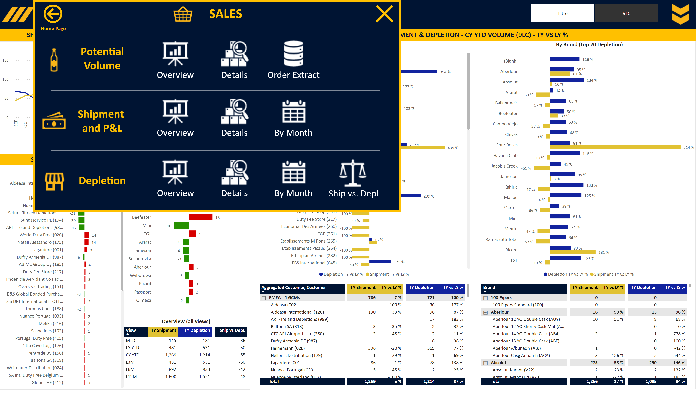
S_Shipment vs Depletion
Notes:
Slicer Units
No alt text provided
Image Open
No alt text provided
Slicer View
No alt text provided
Slicer RSM KAM
No alt text provided
Image Menu
No alt text provided
Area
No alt text provided
slicer
No alt text provided
image
No alt text provided
slicer
No alt text provided
slicer
No alt text provided
slicer
No alt text provided
slicer
No alt text provided
slicer
No alt text provided
slicer
No alt text provided
shape
No alt text provided
shape
No alt text provided
textbox
No alt text provided
Overview (all views)
No alt text provided
By Brand (top 15 Ship vs. Dep)
No alt text provided
By Customer
No alt text provided
Title Card
No alt text provided
By Brand (top 20 Depletion)
No alt text provided
textbox
No alt text provided
pivotTable
No alt text provided
pivotTable
No alt text provided
By Customer
No alt text provided
Title Card
No alt text provided
Title Card
No alt text provided
Monthly Depletion
No alt text provided
Closing box 2
No alt text provided
Personae Text
No alt text provided
Home Page Text
No alt text provided
Home Page Button
No alt text provided
Personae Image
No alt text provided
Closing box 1
No alt text provided
Details Text
No alt text provided
Ship vs Depl Image
No alt text provided
Overview Text
No alt text provided
Ship vs Depl Text
No alt text provided
Details Image
No alt text provided
Depletions Text
No alt text provided
Overview Image
No alt text provided
Depletions Image
No alt text provided
shape
No alt text provided
By Month Text
No alt text provided
By Month Image
No alt text provided
By Month Text
No alt text provided
By Month Image
No alt text provided
Details Text
No alt text provided
Details Image
No alt text provided
Overview Text
No alt text provided
Overview Image
No alt text provided
Actuals Text
No alt text provided
Overview Image
No alt text provided
Actuals Image
No alt text provided
Overview Text
No alt text provided
Extract Text
No alt text provided
Extract Image
No alt text provided
Details Text
No alt text provided
Details Image
No alt text provided
Portfolio Text
No alt text provided
Portfolio Image
No alt text provided
Closing box 3
No alt text provided
Area
No alt text provided
shape
No alt text provided

Slide 24
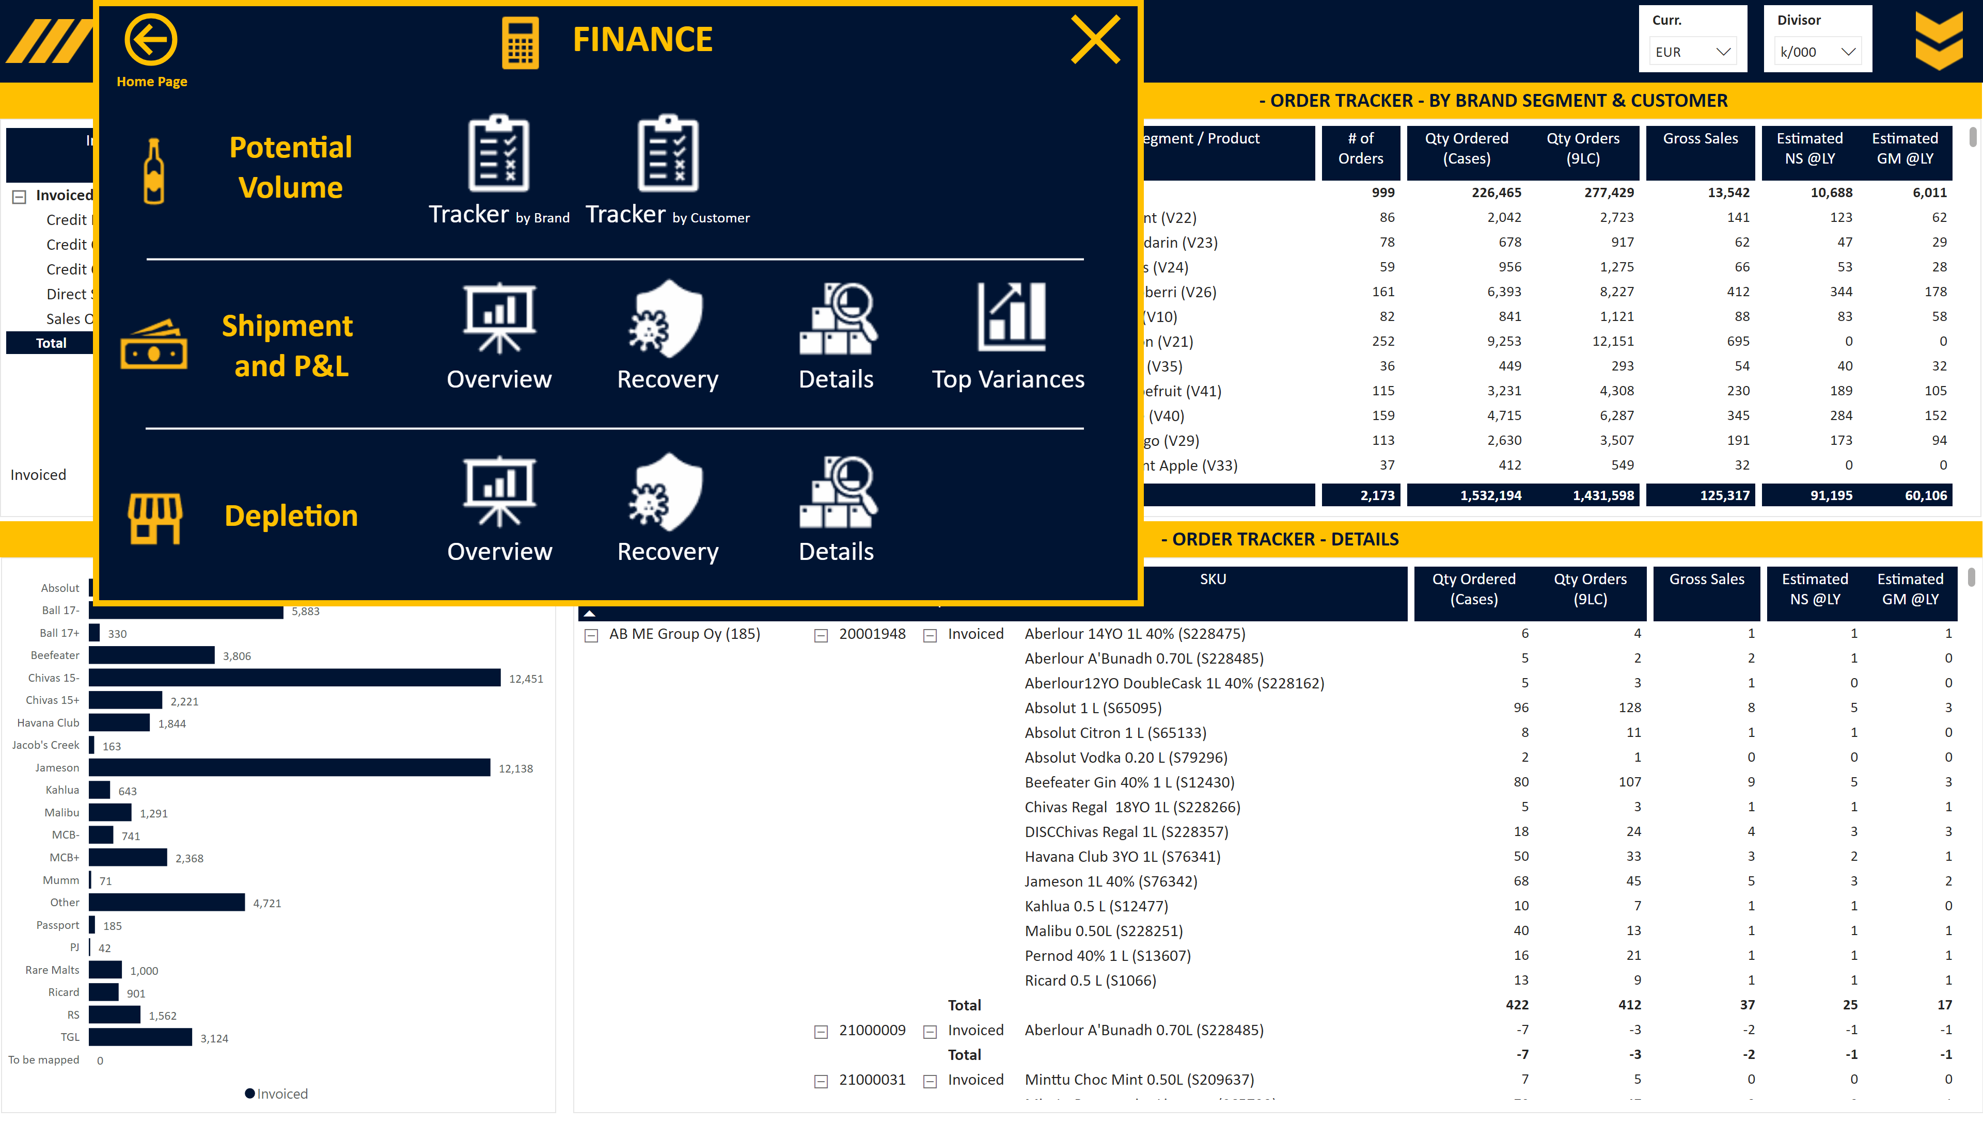
F_Order Tracker Brand
Notes:
Slicer Currency
No alt text provided
Slicer Divisor
No alt text provided
Image Open
No alt text provided
Slicer Period
No alt text provided
Image Menu
No alt text provided
Area
No alt text provided
image
No alt text provided
slicer
No alt text provided
slicer
No alt text provided
slicer
No alt text provided
slicer
No alt text provided
shape
No alt text provided
shape
No alt text provided
pivotTable
No alt text provided
Title Card
No alt text provided
pivotTable
No alt text provided
textbox
No alt text provided
textbox
No alt text provided
By Brand Segment
No alt text provided
Title Card
No alt text provided
Closing box 2
No alt text provided
Personae Image
No alt text provided
Personae Text
No alt text provided
Home Page Text
No alt text provided
Home Page Button
No alt text provided
Recovery Text
No alt text provided
Closing box 1
No alt text provided
Overview Image
No alt text provided
Recovery Text
No alt text provided
Overview Text
No alt text provided
Details Image
No alt text provided
Recovery Image
No alt text provided
Actuals Text
No alt text provided
Depletions Image
No alt text provided
shape
No alt text provided
Top Variances Text
No alt text provided
Details Text
No alt text provided
Top Variances Image
No alt text provided
Details Text
No alt text provided
Details Image
No alt text provided
Overview Text
No alt text provided
Overview Image
No alt text provided
Depletions Text
No alt text provided
Tracker Image
No alt text provided
Actuals Image
No alt text provided
Tracker Text
No alt text provided
Tracker Image
No alt text provided
Tracker Text
No alt text provided
Recovery Image
No alt text provided
Portfolio Text
No alt text provided
Portfolio Image
No alt text provided
Closing box 3
No alt text provided
Area
No alt text provided
shape
No alt text provided
Title Card
No alt text provided
textbox
No alt text provided
pivotTable
No alt text provided
Title Card
No alt text provided
textbox
No alt text provided
pivotTable
No alt text provided

Slide 25
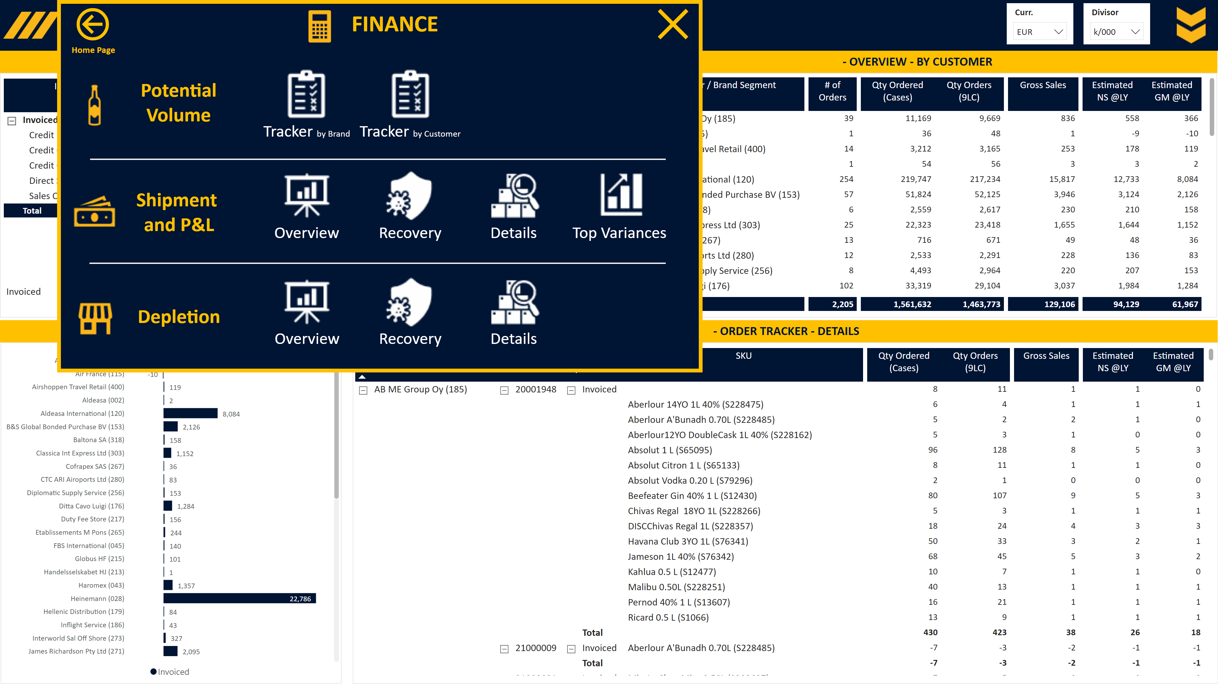
F_Order Tracker Customer
Notes:
Slicer Currency
No alt text provided
Slicer Divisor
No alt text provided
Image Open
No alt text provided
Slicer Period
No alt text provided
Image Menu
No alt text provided
Area
No alt text provided
image
No alt text provided
slicer
No alt text provided
slicer
No alt text provided
slicer
No alt text provided
slicer
No alt text provided
shape
No alt text provided
shape
No alt text provided
pivotTable
No alt text provided
Title Card
No alt text provided
pivotTable
No alt text provided
textbox
No alt text provided
textbox
No alt text provided
By Brand Segment
No alt text provided
Title Card
No alt text provided
Closing box 2
No alt text provided
Personae Image
No alt text provided
Personae Text
No alt text provided
Home Page Text
No alt text provided
Home Page Button
No alt text provided
Recovery Text
No alt text provided
Closing box 1
No alt text provided
Overview Image
No alt text provided
Recovery Text
No alt text provided
Overview Text
No alt text provided
Details Image
No alt text provided
Recovery Image
No alt text provided
Actuals Text
No alt text provided
Depletions Image
No alt text provided
shape
No alt text provided
Top Variances Text
No alt text provided
Details Text
No alt text provided
Top Variances Image
No alt text provided
Details Text
No alt text provided
Details Image
No alt text provided
Overview Text
No alt text provided
Overview Image
No alt text provided
Depletions Text
No alt text provided
Tracker Image
No alt text provided
Actuals Image
No alt text provided
Tracker Text
No alt text provided
Tracker Image
No alt text provided
Tracker Text
No alt text provided
Recovery Image
No alt text provided
Portfolio Text
No alt text provided
Portfolio Image
No alt text provided
Closing box 3
No alt text provided
Area
No alt text provided
shape
No alt text provided
Title Card
No alt text provided
textbox
No alt text provided
pivotTable
No alt text provided
Title Card
No alt text provided
textbox
No alt text provided
pivotTable
No alt text provided

Slide 26
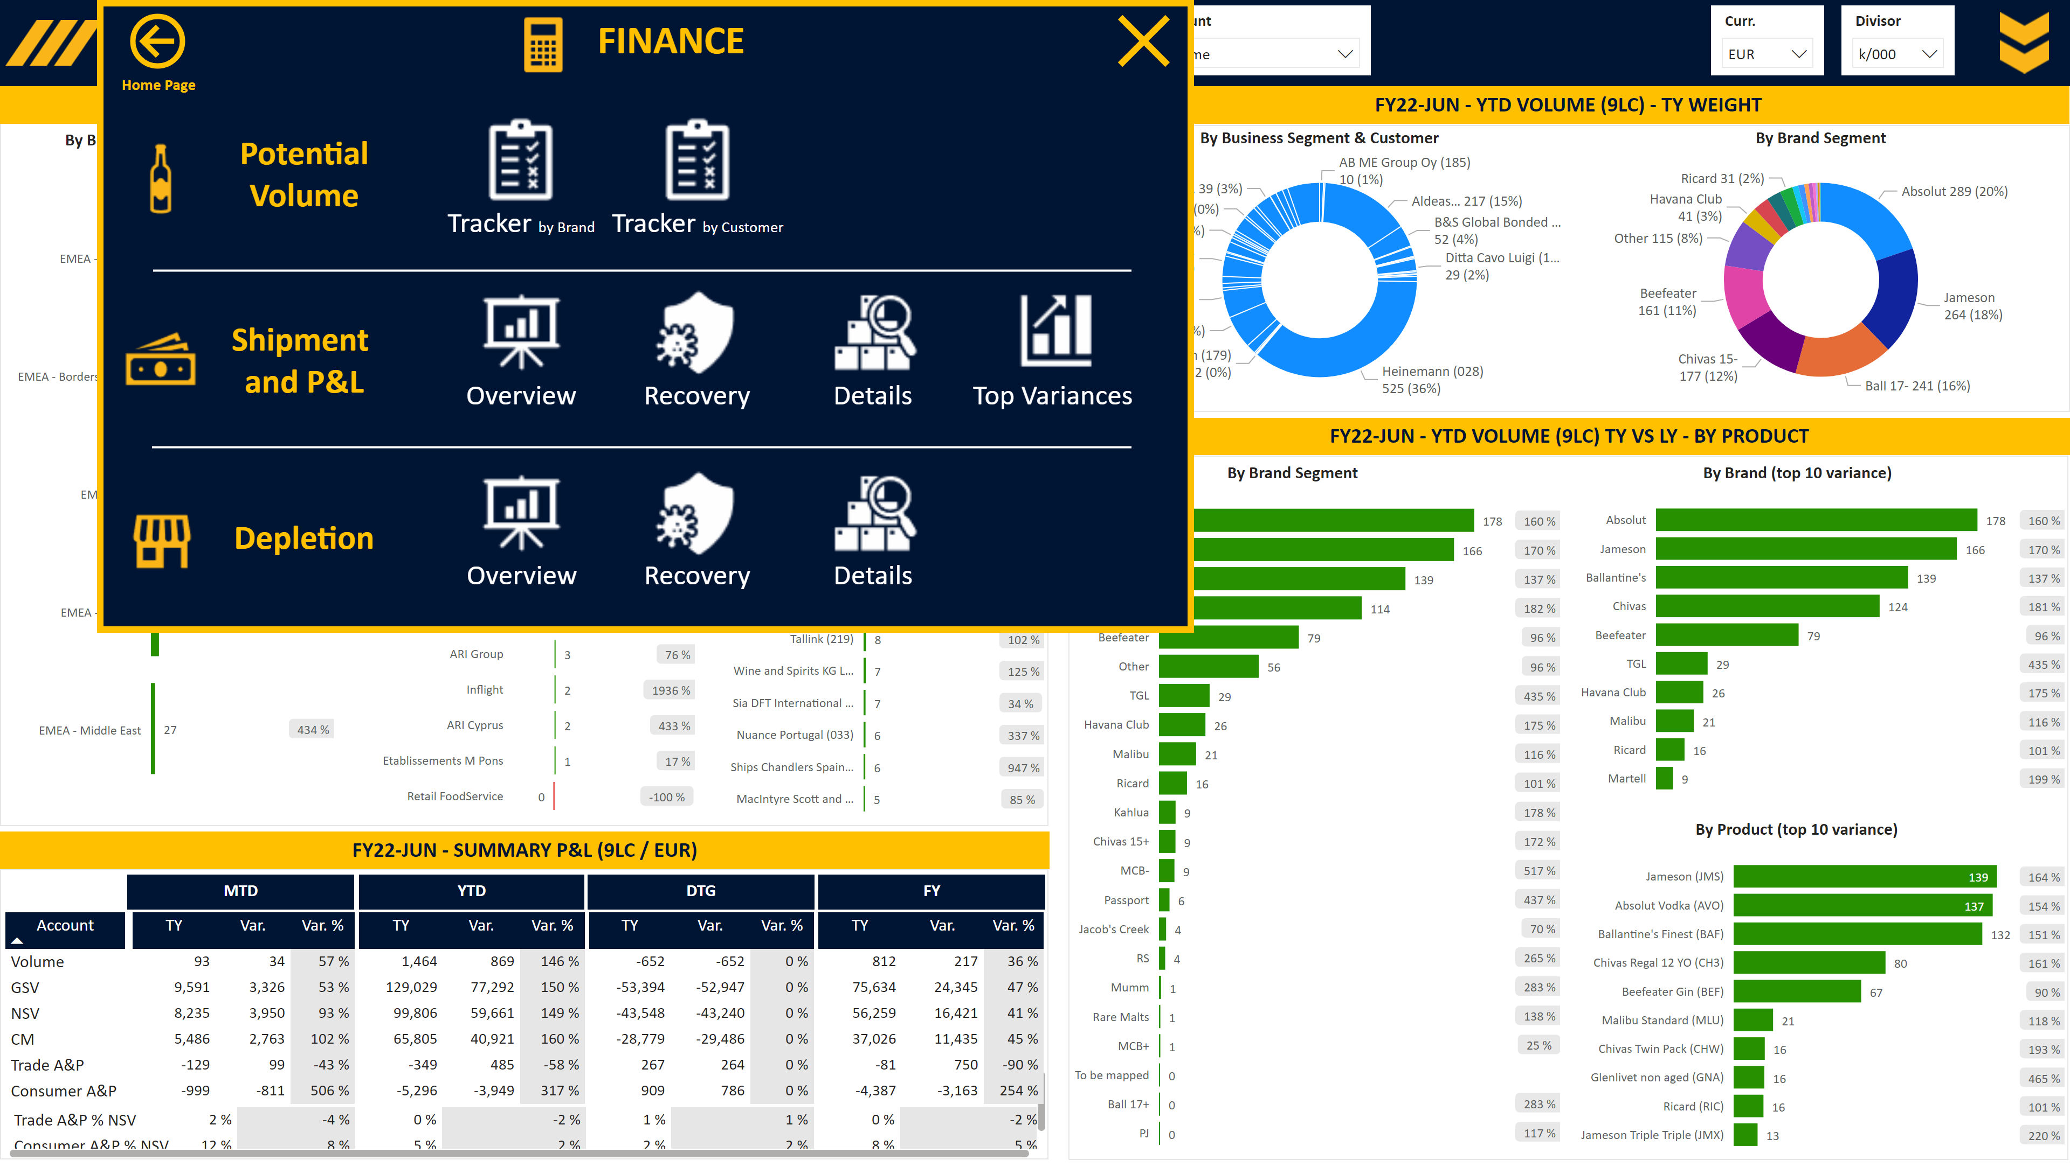
F_Shipment Overview
Notes:
Slicer Currency
No alt text provided
Slicer Divisor
No alt text provided
Image Open
No alt text provided
Slicer Account
No alt text provided
Slicer Base
No alt text provided
Slicer Period
No alt text provided
Slicer View
No alt text provided
Slicer Full Year
No alt text provided
Image Menu
No alt text provided
Area
No alt text provided
image
No alt text provided
slicer
No alt text provided
slicer
No alt text provided
slicer
No alt text provided
slicer
No alt text provided
slicer
No alt text provided
shape
No alt text provided
shape
No alt text provided
By Brand Segment
No alt text provided
By Business Segment & Customer
No alt text provided
Title Card
No alt text provided
textbox
No alt text provided
textbox
No alt text provided
%
No alt text provided
%
No alt text provided
%
No alt text provided
By Customer (top 20 variance)
No alt text provided
By Aggregated Customer
No alt text provided
By Business Segment
No alt text provided
Title Card
No alt text provided
Title Card
No alt text provided
Title MTD
No alt text provided
Title YTD
No alt text provided
Title DTG
No alt text provided
pivotTable
No alt text provided
textbox
No alt text provided
pivotTable
No alt text provided
Title FY
No alt text provided
textbox
No alt text provided
%
No alt text provided
%
No alt text provided
%
No alt text provided
By Product (top 10 variance)
No alt text provided
By Brand (top 10 variance)
No alt text provided
By Brand Segment
No alt text provided
Title Card
No alt text provided
Closing box 2
No alt text provided
Personae Image
No alt text provided
Personae Text
No alt text provided
Home Page Text
No alt text provided
Home Page Button
No alt text provided
Recovery Text
No alt text provided
Closing box 1
No alt text provided
Overview Image
No alt text provided
Recovery Text
No alt text provided
Overview Text
No alt text provided
Details Image
No alt text provided
Recovery Image
No alt text provided
Actuals Text
No alt text provided
Depletions Image
No alt text provided
shape
No alt text provided
Top Variances Text
No alt text provided
Details Text
No alt text provided
Top Variances Image
No alt text provided
Details Text
No alt text provided
Details Image
No alt text provided
Overview Text
No alt text provided
Overview Image
No alt text provided
Depletions Text
No alt text provided
Tracker Text
No alt text provided
Tracker Image
No alt text provided
Tracker Image
No alt text provided
Actuals Image
No alt text provided
Tracker Text
No alt text provided
Recovery Image
No alt text provided
Portfolio Text
No alt text provided
Portfolio Image
No alt text provided
Closing box 3
No alt text provided
Area
No alt text provided
shape
No alt text provided

Slide 27
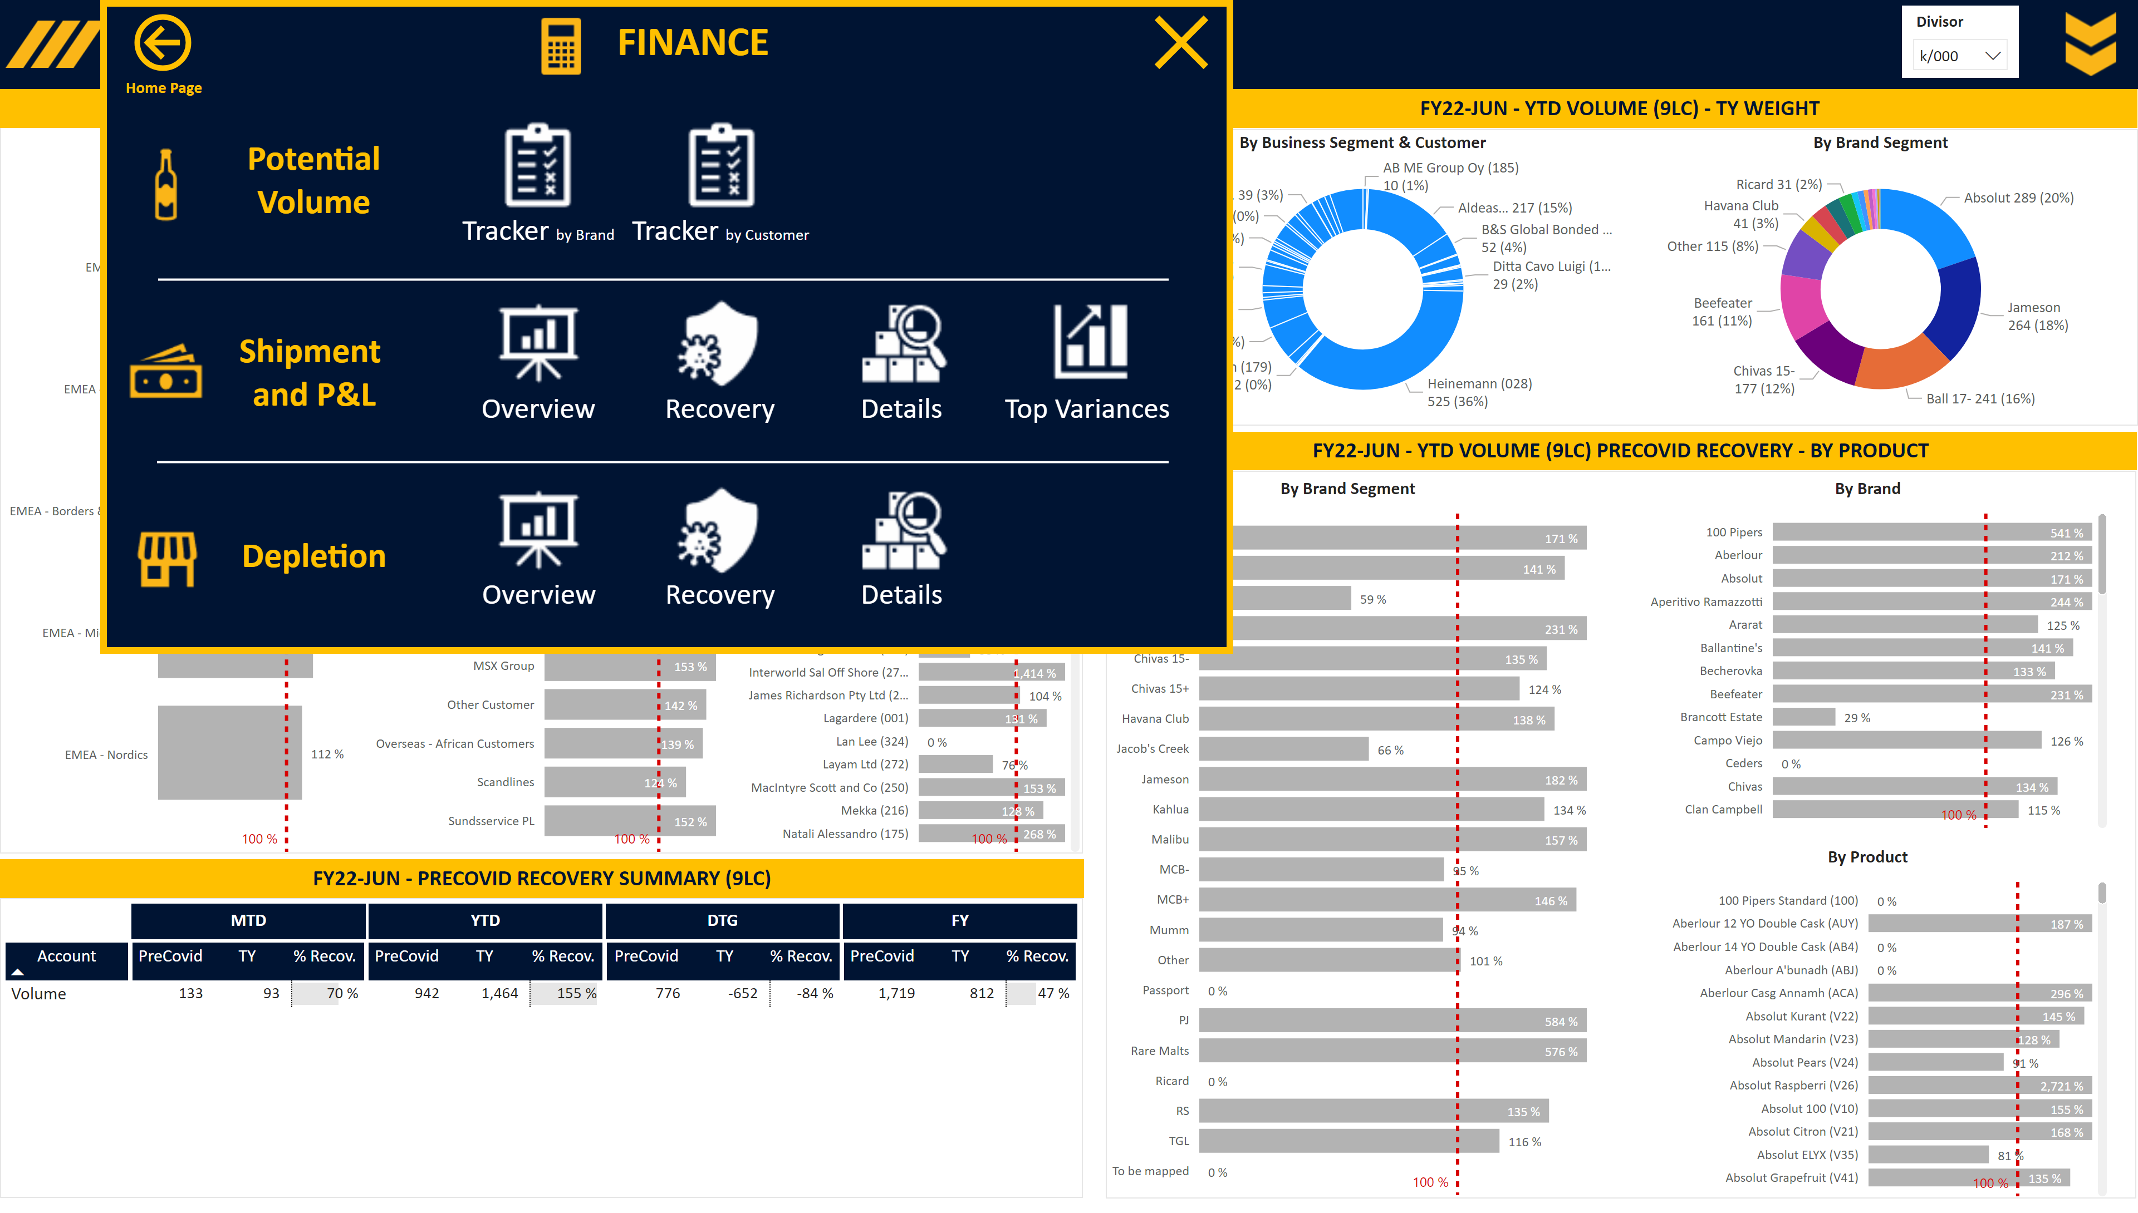
F_Shipment Overview Recovery
Notes:
Slicer Divisor
No alt text provided
Image Open
No alt text provided
Slicer Period
No alt text provided
Slicer View
No alt text provided
Slicer Full Year
No alt text provided
Image Menu
No alt text provided
Area
No alt text provided
image
No alt text provided
slicer
No alt text provided
slicer
No alt text provided
slicer
No alt text provided
slicer
No alt text provided
slicer
No alt text provided
shape
No alt text provided
shape
No alt text provided
By Brand Segment
No alt text provided
By Business Segment & Customer
No alt text provided
Title Card
No alt text provided
textbox
No alt text provided
textbox
No alt text provided
By Aggregated Customer
No alt text provided
By Customer
No alt text provided
By Business Segment
No alt text provided
Title Card
No alt text provided
Title Card
No alt text provided
Title MTD
No alt text provided
Title YTD
No alt text provided
Title DTG
No alt text provided
textbox
No alt text provided
pivotTable
No alt text provided
Title FY
No alt text provided
textbox
No alt text provided
By Product
No alt text provided
By Brand
No alt text provided
By Brand Segment
No alt text provided
Title Card
No alt text provided
Closing box 2
No alt text provided
Personae Image
No alt text provided
Personae Text
No alt text provided
Home Page Text
No alt text provided
Home Page Button
No alt text provided
Recovery Text
No alt text provided
Closing box 1
No alt text provided
Overview Image
No alt text provided
Recovery Text
No alt text provided
Overview Text
No alt text provided
Details Image
No alt text provided
Recovery Image
No alt text provided
Actuals Text
No alt text provided
Depletions Image
No alt text provided
shape
No alt text provided
Top Variances Text
No alt text provided
Details Text
No alt text provided
Top Variances Image
No alt text provided
Details Text
No alt text provided
Details Image
No alt text provided
Overview Text
No alt text provided
Overview Image
No alt text provided
Depletions Text
No alt text provided
Tracker Image
No alt text provided
Actuals Image
No alt text provided
Tracker Text
No alt text provided
Tracker Image
No alt text provided
Tracker Text
No alt text provided
Recovery Image
No alt text provided
Portfolio Text
No alt text provided
Portfolio Image
No alt text provided
Closing box 3
No alt text provided
Area
No alt text provided
shape
No alt text provided

Slide 28
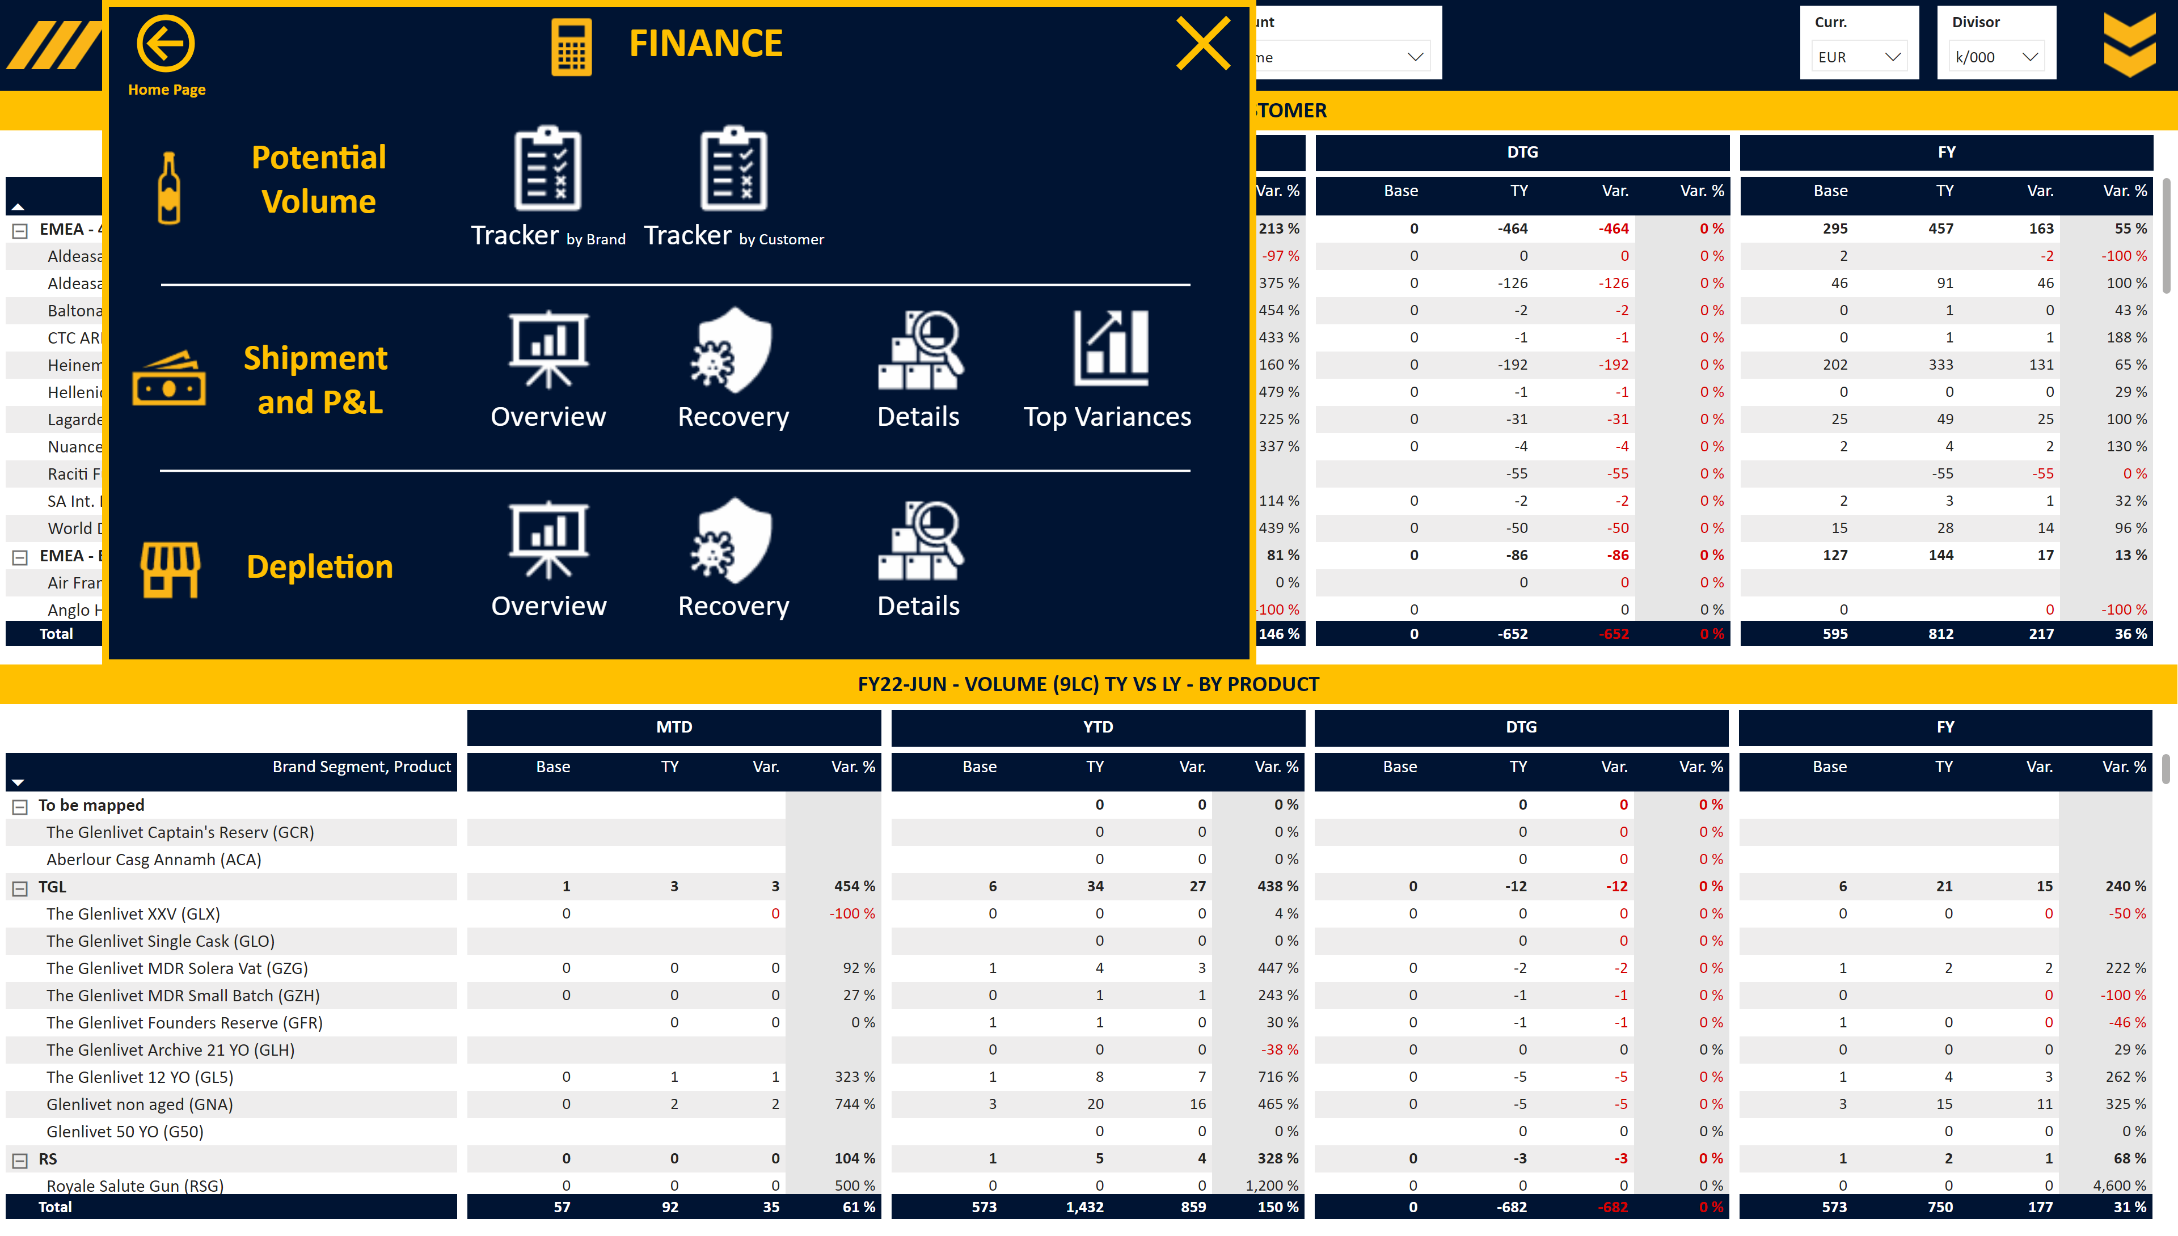
F_Shipment Detailed
Notes:
Slicer Currency
No alt text provided
Slicer Divisor
No alt text provided
Image Open
No alt text provided
Slicer Account
No alt text provided
Slicer Base
No alt text provided
Slicer Period
No alt text provided
Slicer Full Year
No alt text provided
Image Menu
No alt text provided
Area
No alt text provided
image
No alt text provided
slicer
No alt text provided
slicer
No alt text provided
slicer
No alt text provided
slicer
No alt text provided
slicer
No alt text provided
shape
No alt text provided
shape
No alt text provided
Closing box 2
No alt text provided
Personae Image
No alt text provided
Personae Text
No alt text provided
Home Page Text
No alt text provided
Home Page Button
No alt text provided
Recovery Text
No alt text provided
Closing box 1
No alt text provided
Overview Image
No alt text provided
Recovery Text
No alt text provided
Overview Text
No alt text provided
Details Image
No alt text provided
Recovery Image
No alt text provided
Actuals Text
No alt text provided
Depletions Image
No alt text provided
shape
No alt text provided
Top Variances Text
No alt text provided
Details Text
No alt text provided
Top Variances Image
No alt text provided
Details Text
No alt text provided
Details Image
No alt text provided
Overview Text
No alt text provided
Overview Image
No alt text provided
Depletions Text
No alt text provided
Tracker Image
No alt text provided
Actuals Image
No alt text provided
Tracker Text
No alt text provided
Tracker Image
No alt text provided
Tracker Text
No alt text provided
Recovery Image
No alt text provided
Portfolio Text
No alt text provided
Portfolio Image
No alt text provided
Closing box 3
No alt text provided
Area
No alt text provided
shape
No alt text provided
Title Card
No alt text provided
Title MTD
No alt text provided
Title YTD
No alt text provided
Title DTG
No alt text provided
Title Full Year
No alt text provided
pivotTable
No alt text provided
Title Card
No alt text provided
Title MTD
No alt text provided
Title YTD
No alt text provided
Title DTG
No alt text provided
Title Full Year
No alt text provided
pivotTable
No alt text provided

Slide 29
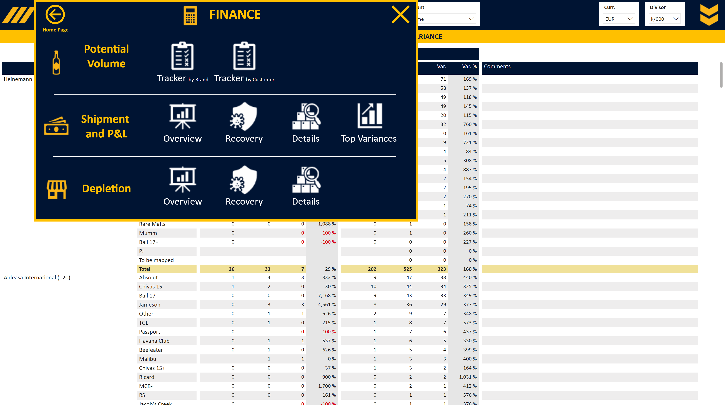
F_Shipment Variances
Notes:
Slicer Currency
No alt text provided
Slicer Divisor
No alt text provided
Image Open
No alt text provided
Slicer Account
No alt text provided
Slicer Base
No alt text provided
Slicer Period
No alt text provided
Slicer RSM KAM
No alt text provided
Image Menu
No alt text provided
Area
No alt text provided
image
No alt text provided
slicer
No alt text provided
slicer
No alt text provided
slicer
No alt text provided
slicer
No alt text provided
slicer
No alt text provided
shape
No alt text provided
shape
No alt text provided
Closing box 2
No alt text provided
Personae Image
No alt text provided
Personae Text
No alt text provided
Home Page Text
No alt text provided
Home Page Button
No alt text provided
Recovery Text
No alt text provided
Closing box 1
No alt text provided
Overview Image
No alt text provided
Recovery Text
No alt text provided
Overview Text
No alt text provided
Details Image
No alt text provided
Recovery Image
No alt text provided
Actuals Text
No alt text provided
Depletions Image
No alt text provided
shape
No alt text provided
Top Variances Text
No alt text provided
Details Text
No alt text provided
Top Variances Image
No alt text provided
Details Text
No alt text provided
Details Image
No alt text provided
Overview Text
No alt text provided
Overview Image
No alt text provided
Depletions Text
No alt text provided
Tracker Image
No alt text provided
Actuals Image
No alt text provided
Tracker Text
No alt text provided
Tracker Image
No alt text provided
Tracker Text
No alt text provided
Recovery Image
No alt text provided
Portfolio Text
No alt text provided
Portfolio Image
No alt text provided
Closing box 3
No alt text provided
Area
No alt text provided
shape
No alt text provided
Title Card
No alt text provided
Title MTD
No alt text provided
Title YTD
No alt text provided
pivotTable
No alt text provided

Slide 30
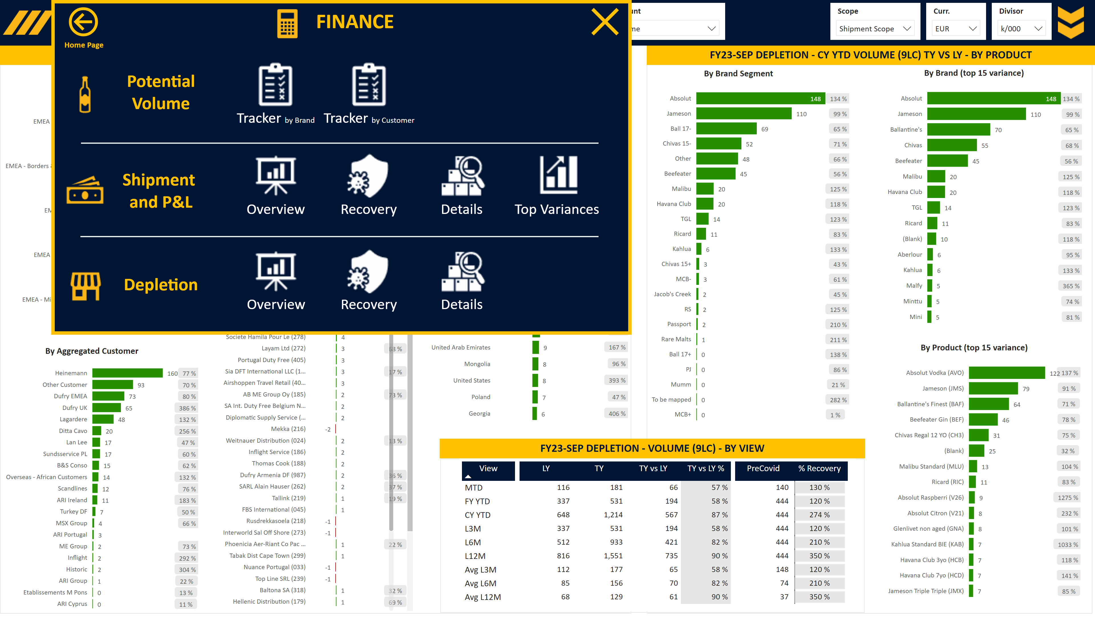
F_Depletion Overview
Notes:
Slicer Currency
No alt text provided
Image Open
No alt text provided
Slicer Scope
No alt text provided
Slicer Divisor
No alt text provided
Slicer Account
No alt text provided
Slicer Period
No alt text provided
Slicer View
No alt text provided
Image Menu
No alt text provided
Area
No alt text provided
slicer
No alt text provided
image
No alt text provided
slicer
No alt text provided
slicer
No alt text provided
slicer
No alt text provided
slicer
No alt text provided
slicer
No alt text provided
shape
No alt text provided
shape
No alt text provided
textbox
No alt text provided
%
No alt text provided
By Country (top 15 variance)
No alt text provided
%
No alt text provided
By Aggregated Customer
No alt text provided
%
No alt text provided
By Customer
No alt text provided
%
No alt text provided
By Business Segment
No alt text provided
Title Card
No alt text provided
textbox
No alt text provided
pivotTable
No alt text provided
Title Card
No alt text provided
textbox
No alt text provided
%
No alt text provided
By Product (top 15 variance)
No alt text provided
%
No alt text provided
By Brand (top 15 variance)
No alt text provided
%
No alt text provided
By Brand Segment
No alt text provided
Title Card
No alt text provided
Closing box 2
No alt text provided
Personae Image
No alt text provided
Personae Text
No alt text provided
Home Page Text
No alt text provided
Home Page Button
No alt text provided
Recovery Text
No alt text provided
Closing box 1
No alt text provided
Overview Image
No alt text provided
Recovery Text
No alt text provided
Overview Text
No alt text provided
Details Image
No alt text provided
Recovery Image
No alt text provided
Actuals Text
No alt text provided
Depletions Image
No alt text provided
shape
No alt text provided
Top Variances Text
No alt text provided
Details Text
No alt text provided
Top Variances Image
No alt text provided
Details Text
No alt text provided
Details Image
No alt text provided
Overview Text
No alt text provided
Overview Image
No alt text provided
Depletions Text
No alt text provided
Tracker Image
No alt text provided
Actuals Image
No alt text provided
Tracker Text
No alt text provided
Tracker Image
No alt text provided
Tracker Text
No alt text provided
Recovery Image
No alt text provided
Portfolio Text
No alt text provided
Portfolio Image
No alt text provided
Closing box 3
No alt text provided
Area
No alt text provided
shape
No alt text provided

Slide 31
F_Depletion Overview Tooltip
Notes:
Monthly Depletion
No alt text provided
Title Card
No alt text provided

Slide 32
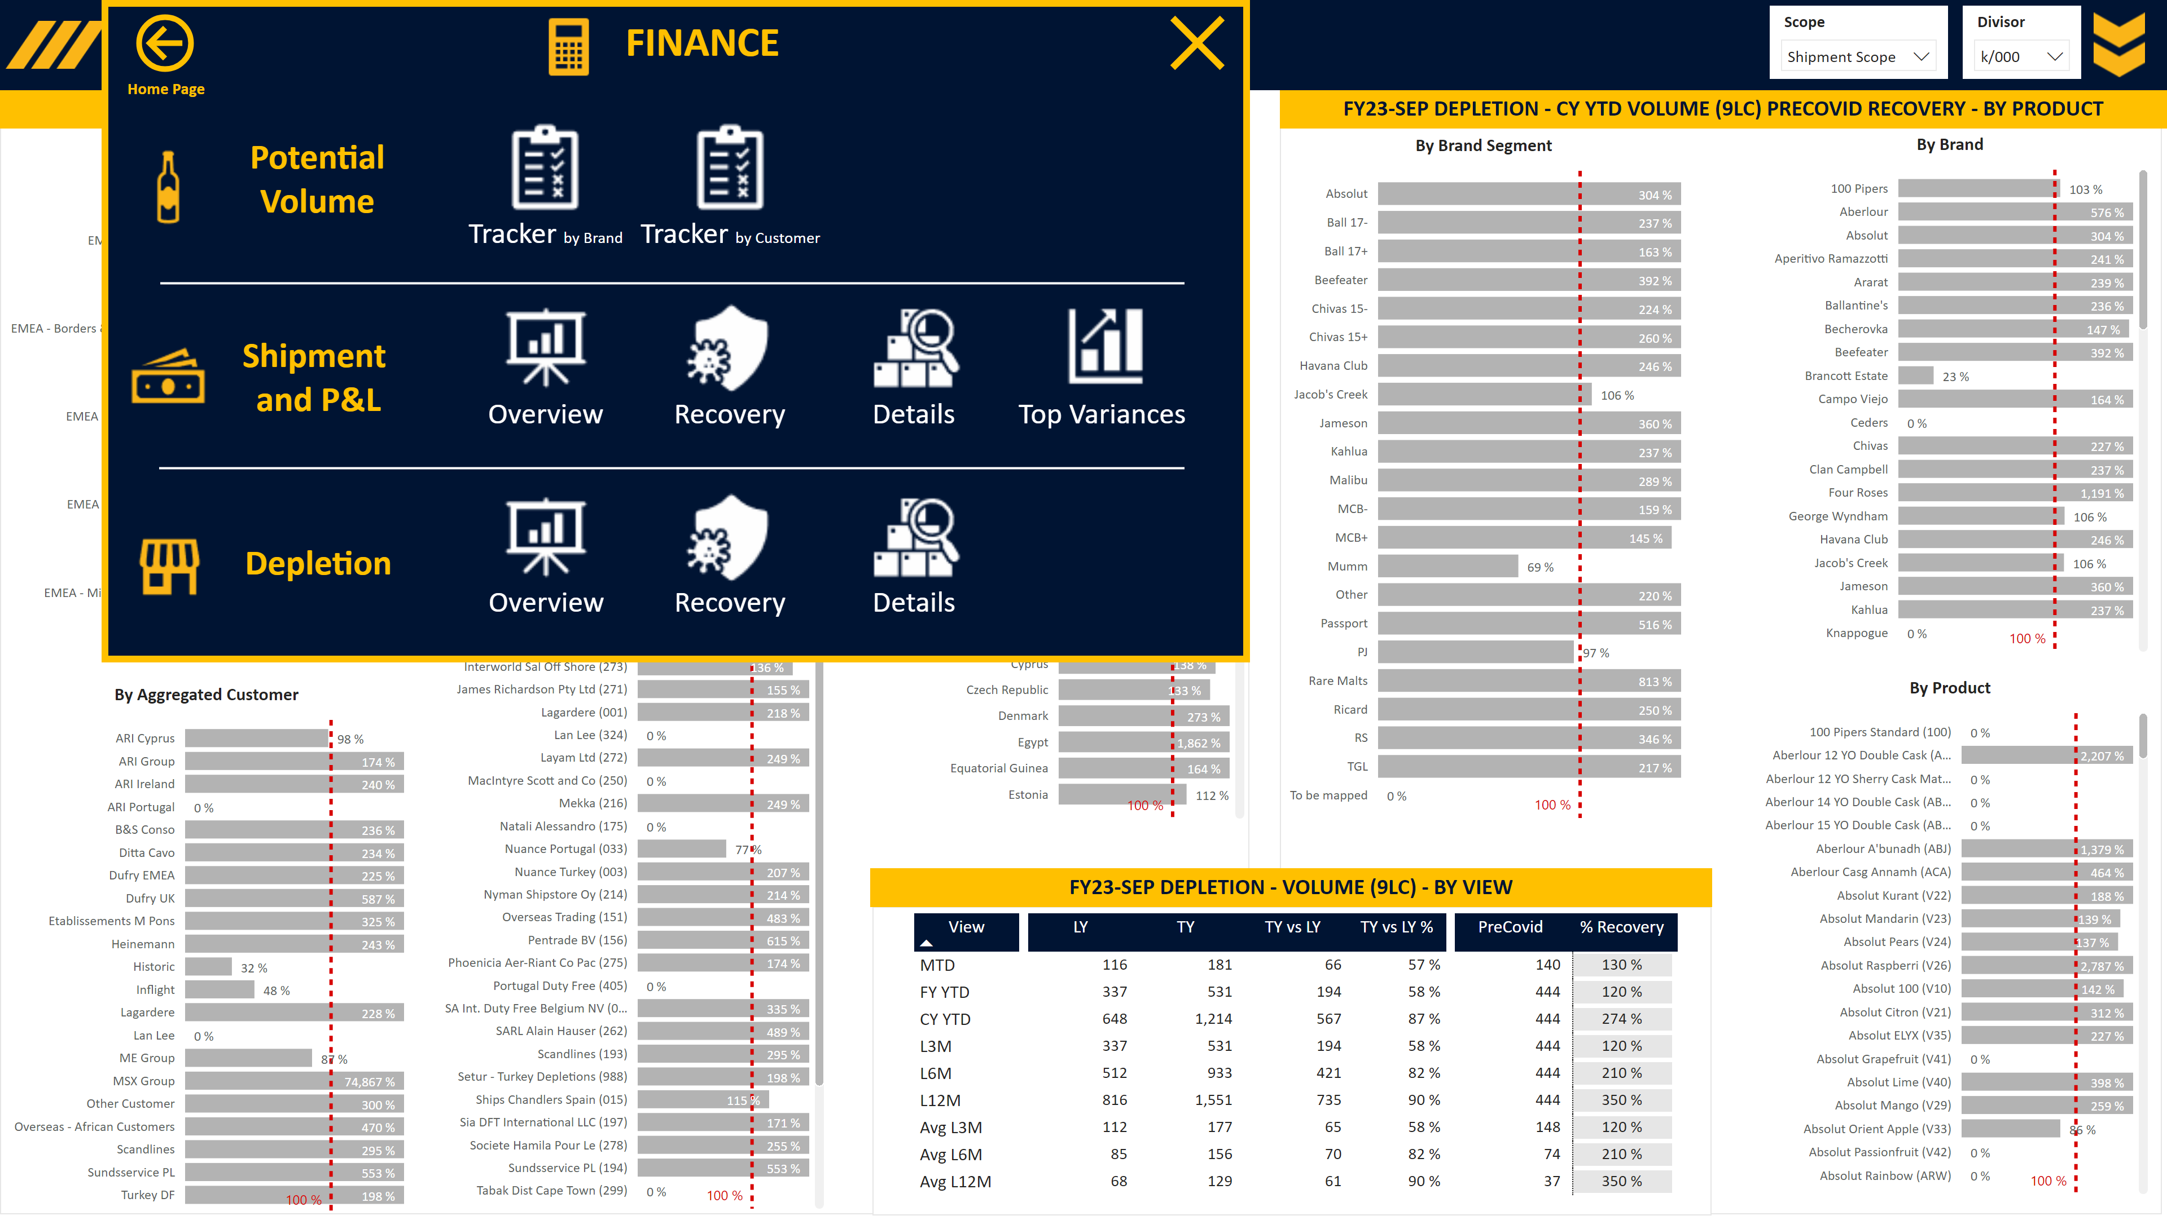
F_Depletion Recovery Overview
Notes:
Image Open
No alt text provided
Slicer Scope
No alt text provided
Slicer Divisor
No alt text provided
Slicer Period
No alt text provided
Slicer View
No alt text provided
Image Menu
No alt text provided
Area
No alt text provided
slicer
No alt text provided
image
No alt text provided
slicer
No alt text provided
slicer
No alt text provided
slicer
No alt text provided
slicer
No alt text provided
slicer
No alt text provided
shape
No alt text provided
shape
No alt text provided
textbox
No alt text provided
By Country
No alt text provided
By Aggregated Customer
No alt text provided
By Customer
No alt text provided
By Business Segment
No alt text provided
Title Card
No alt text provided
textbox
No alt text provided
pivotTable
No alt text provided
Title Card
No alt text provided
textbox
No alt text provided
By Product
No alt text provided
By Brand
No alt text provided
By Brand Segment
No alt text provided
Title Card
No alt text provided
Closing box 2
No alt text provided
Personae Image
No alt text provided
Personae Text
No alt text provided
Home Page Text
No alt text provided
Home Page Button
No alt text provided
Recovery Text
No alt text provided
Closing box 1
No alt text provided
Overview Image
No alt text provided
Recovery Text
No alt text provided
Overview Text
No alt text provided
Details Image
No alt text provided
Recovery Image
No alt text provided
Actuals Text
No alt text provided
Depletions Image
No alt text provided
shape
No alt text provided
Top Variances Text
No alt text provided
Details Text
No alt text provided
Top Variances Image
No alt text provided
Details Text
No alt text provided
Details Image
No alt text provided
Overview Text
No alt text provided
Overview Image
No alt text provided
Depletions Text
No alt text provided
Tracker Image
No alt text provided
Actuals Image
No alt text provided
Tracker Text
No alt text provided
Tracker Image
No alt text provided
Tracker Text
No alt text provided
Recovery Image
No alt text provided
Portfolio Text
No alt text provided
Portfolio Image
No alt text provided
Closing box 3
No alt text provided
Area
No alt text provided
shape
No alt text provided

Slide 33
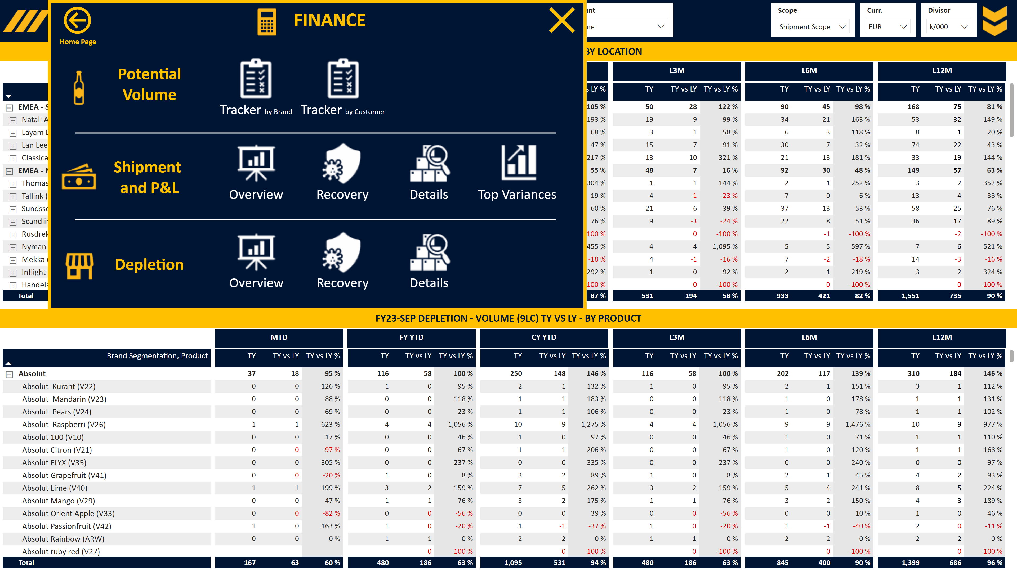
F_Depletion Detailed
Notes:
Slicer Currency
No alt text provided
Image Open
No alt text provided
Slicer Scope
No alt text provided
Slicer Divisor
No alt text provided
Slicer Account
No alt text provided
Slicer Period
No alt text provided
Image Menu
No alt text provided
Area
No alt text provided
slicer
No alt text provided
image
No alt text provided
slicer
No alt text provided
slicer
No alt text provided
slicer
No alt text provided
slicer
No alt text provided
slicer
No alt text provided
shape
No alt text provided
shape
No alt text provided
Title Card
No alt text provided
Title CY YTD
No alt text provided
Title FY YTD
No alt text provided
Title MTD
No alt text provided
Title L3M
No alt text provided
Title L6M
No alt text provided
Title L12M
No alt text provided
pivotTable
No alt text provided
Title Card
No alt text provided
Title CY YTD
No alt text provided
Title FY YTD
No alt text provided
Title MTD
No alt text provided
Title L3M
No alt text provided
Title L6M
No alt text provided
Title L12M
No alt text provided
pivotTable
No alt text provided
Closing box 2
No alt text provided
Personae Image
No alt text provided
Personae Text
No alt text provided
Home Page Text
No alt text provided
Home Page Button
No alt text provided
Recovery Text
No alt text provided
Closing box 1
No alt text provided
Overview Image
No alt text provided
Recovery Text
No alt text provided
Overview Text
No alt text provided
Details Image
No alt text provided
Recovery Image
No alt text provided
Actuals Text
No alt text provided
Depletions Image
No alt text provided
shape
No alt text provided
Top Variances Text
No alt text provided
Details Text
No alt text provided
Top Variances Image
No alt text provided
Details Text
No alt text provided
Details Image
No alt text provided
Overview Text
No alt text provided
Overview Image
No alt text provided
Depletions Text
No alt text provided
Tracker Image
No alt text provided
Actuals Image
No alt text provided
Tracker Text
No alt text provided
Tracker Image
No alt text provided
Tracker Text
No alt text provided
Recovery Image
No alt text provided
Portfolio Text
No alt text provided
Portfolio Image
No alt text provided
Closing box 3
No alt text provided
Area
No alt text provided
shape
No alt text provided

